Slide 1
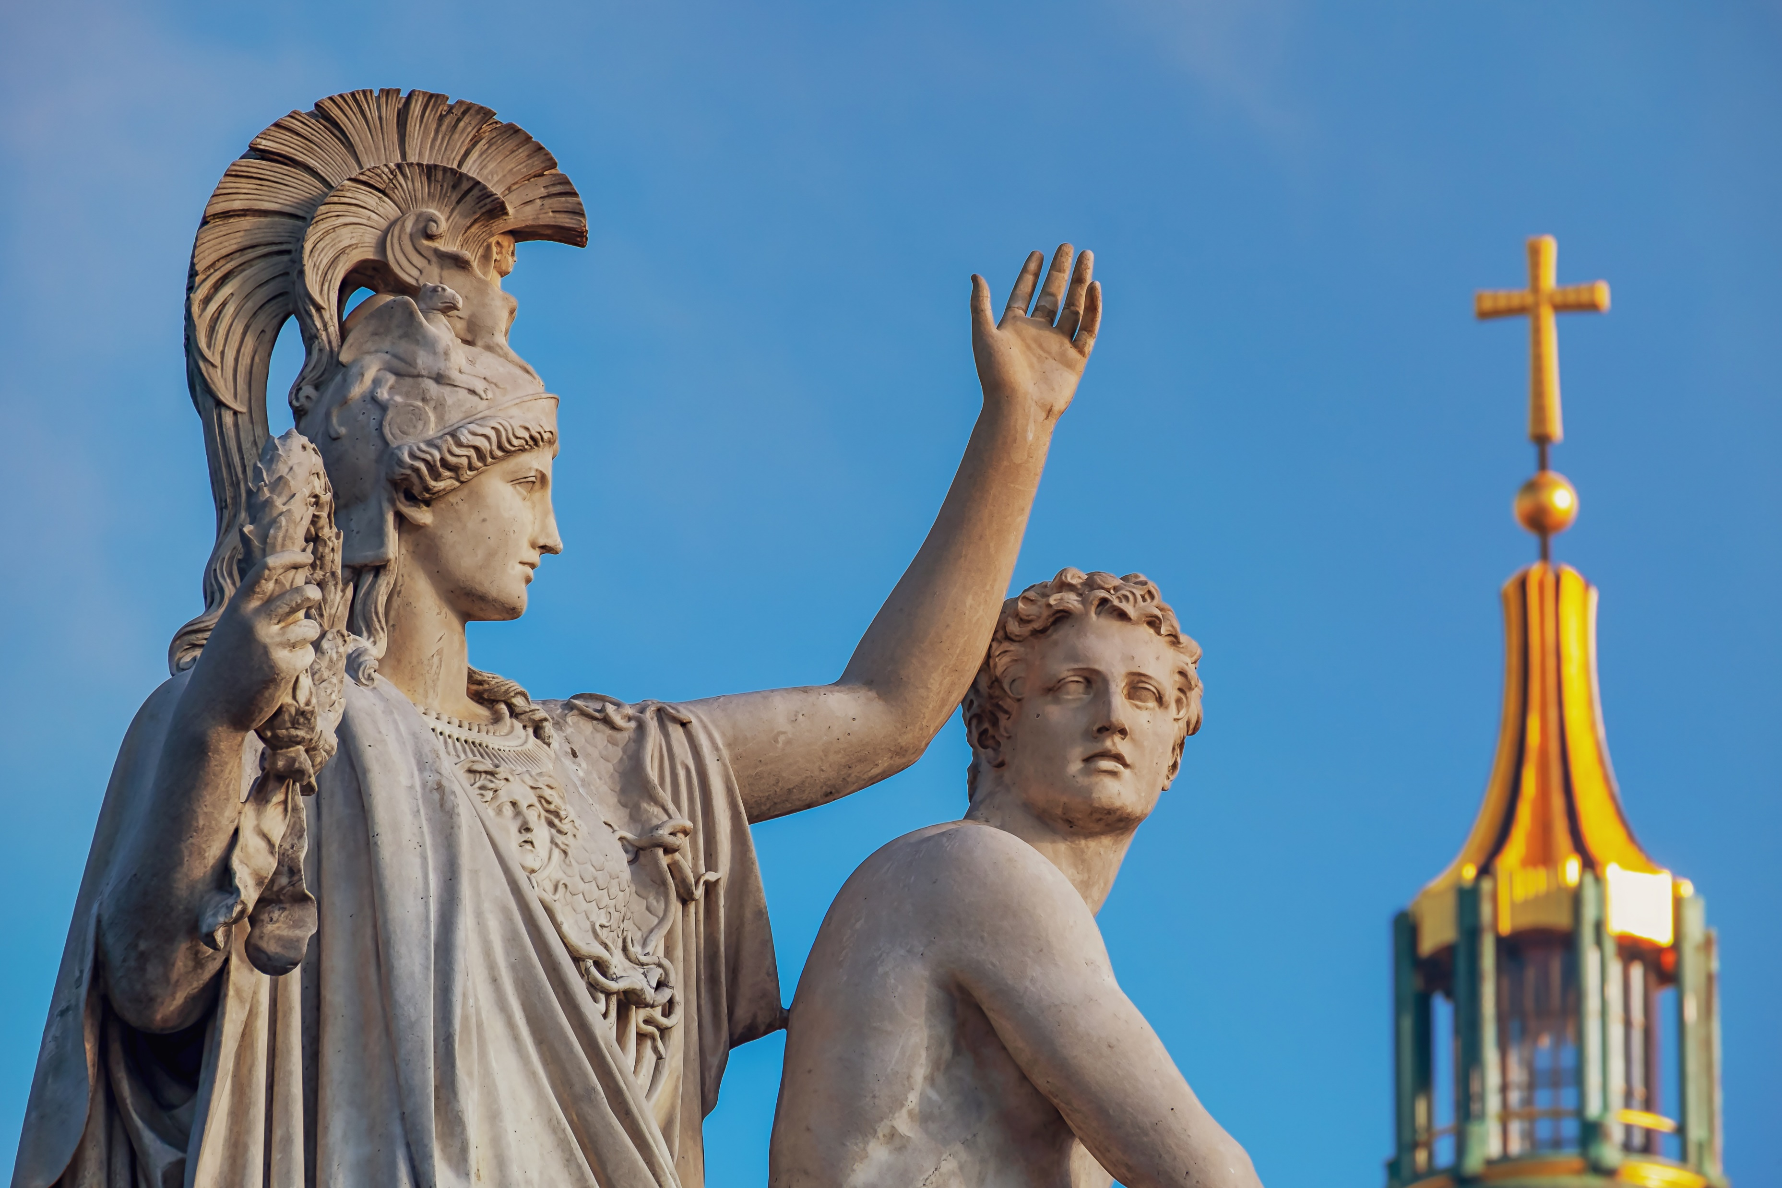
The Historical Coins of Christianity From Biblical to Medieval

Slide 2
ILYA ZLOBIN World-Renowned Ancient Coin Expert Enthusiast, Author and Dealer
Author of Dozens of Articles and Videos about Ancient Coins and Coin collecting
Dealing in Ancient Coins for Over a Decade
Has worked with over 80,000 ancient medieval and world coins and artifacts
Has ONLINE SHOP with over 19,000 item selection
For more information visit: www.TrustedCoins.com

Slide 3
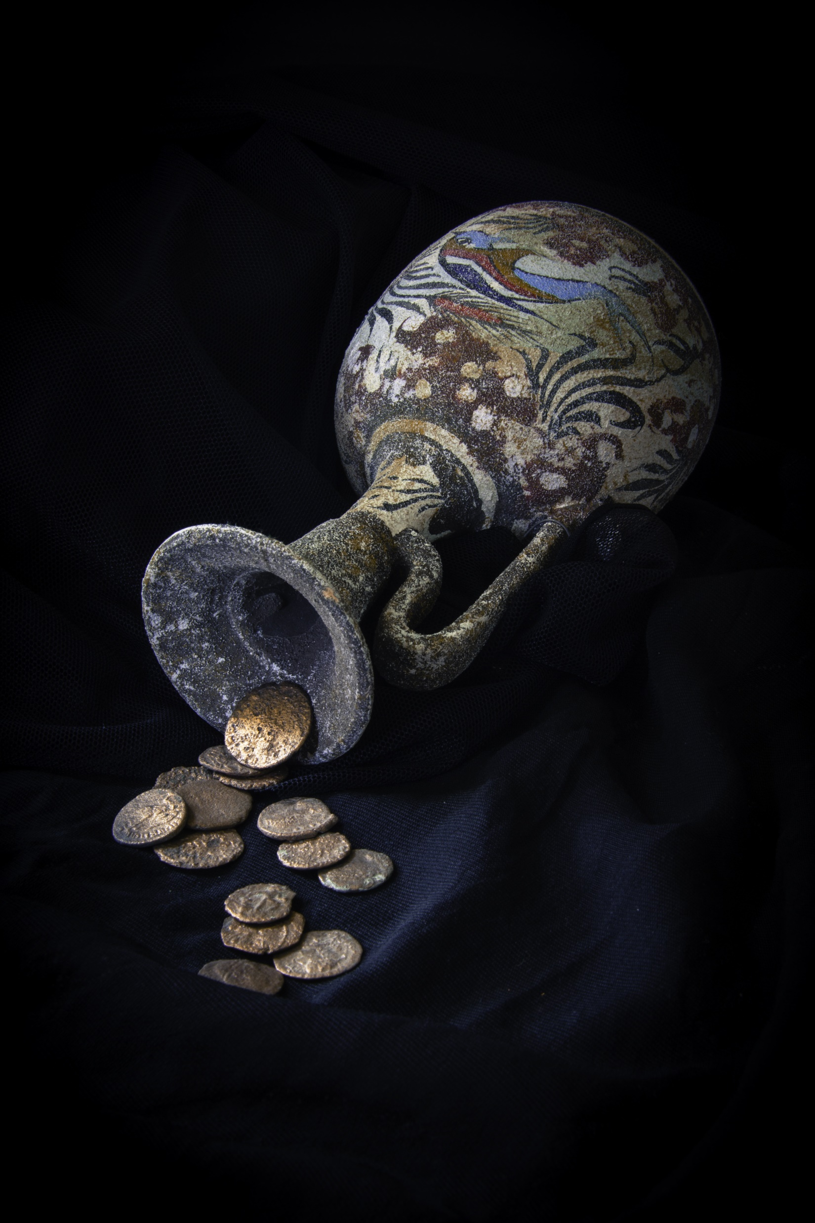
Reasons to Study and Collect Ancient Coins
Connect to the past
Develop a deeper understanding of the time period
Make amazing family heirlooms
Historical proof
True Wealth
Limited in number and unique
Preserves the past for future generations

Slide 4
Ancient Jerusalem Coins
Ancient Jerusalem had several Jewish kings and the coins the most widely known coin from the bible is called the ‘widow’s mite’
Mark 12:38-44 King James Version (KJV)
⁴² And there came a certain poor widow, and she threw in two mites, which make a farthing.
⁴³ And he called unto him his disciples, and saith unto them, Verily I say unto you, That this poor widow hath cast more in, than all they which have cast into the treasury:
⁴⁴ For all they did cast in of their abundance; but she of her want did cast in all that she had, even all her living.

Slide 5
Widow’s Mite Possibilities
What we know is that the coins were of the lowest denomination, so it would be either the Prutah or Half Prutah coin, the bible does not say which one specifically but, it will be most likely a circulating coin of the time so here are some examples, John Hyrcanus, Alexander Jannaeus and possibly even later Prutah coins
Historically significant coin to those of both Jewish and Christian faiths, along with people that are interested in studying history. To the Jewish peoples, this coin represents an important historical Jewish king of the Hosmoneon dynasty. To Christians studying biblical history, this coin could be considered as a "Widow's Mite" from the bible. The prutah was the smallest (other than the half prutah) circulating coin in the area of Jerusalem during the time of Jesus Christ. It took about 10 prutah coins to buy a loaf of bread during those times. The bible does not make it clear which of the coins was donated by the poor widow, but it could be certain that it was a prutah or half prutah coin. Prutahs of Alexander Jananeus would have been common to circulation and some of his coins were struck in such vast numbers, they could be the least valuable coins to be considered a poor widow's mite. The exchange rate for a silver shekel would have been about 256 prutah coins. There were several Jewish rulers whom struck coins that could be considered a "widow's mite". And the conclusion that can be made that any circulating prutah coin of the area could have been given as donation in that story. Of course there are certain coin types that would be more plentiful or more scarce than others, but logically speaking, since a specific ruler's coin was not named in the bible, any prutahs circulating could have been the coin mentioned in the bible as the "Widow's Mite".

Slide 6
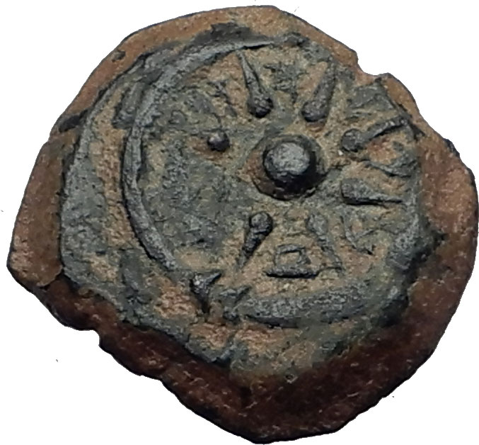
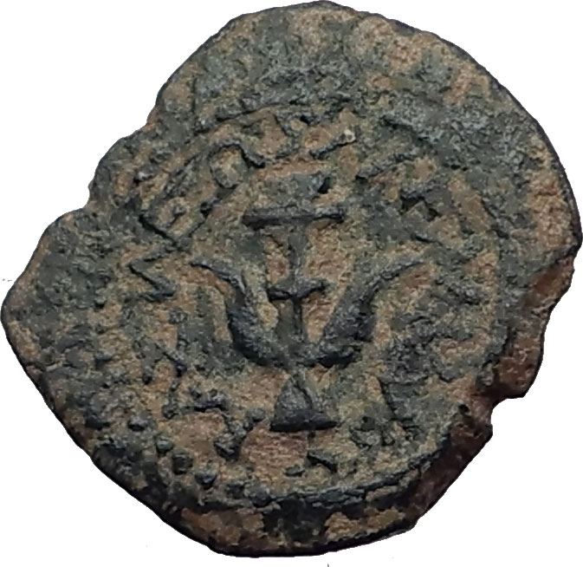
Alexander Jannaeus Jewish King of the Hosmonean Kingdom 103-76 B.C.E. Bronze 'Prutah' 16mm (3.24 grams) mint of Jerusalem 103-76 B.C. Reference: Hendin 1150 (5th Edition); Hendin 469 (3rd Edition) Star of eight rays surrounded by diadem, between the rays, paleo-Hebrew (Yehonatan the King). Anchor, ΒΑΣΙΛΕΩΣ ΛΕΞΑΝΔΡΟΥ (of King Alexander).

Slide 7
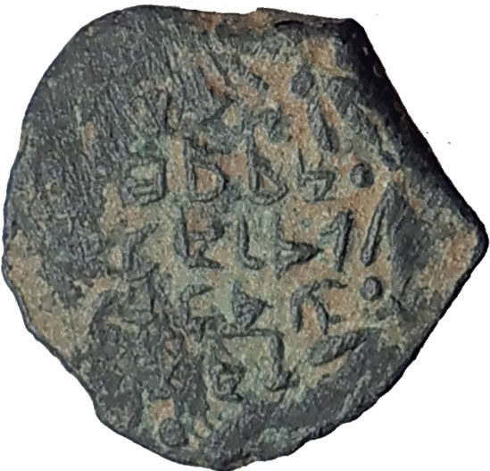
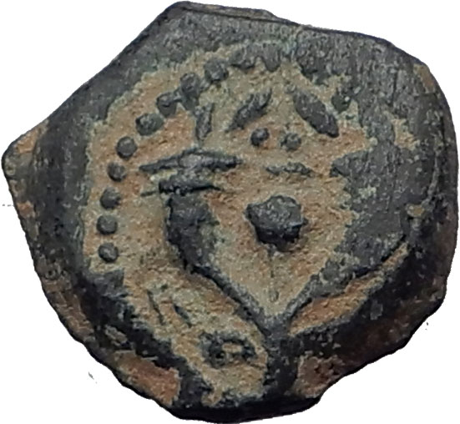
Jewish Coin of John Hyrcanus I (Yehohanan) King of Judaea 134-104 B.C.E Bronze 'Prutah' 14mm (1.74 grams) Jerusalem mint, struck circa 134-104 B.C. Reference: Hendin 1139 Paleo-Hebrew inscription (Yehohanan the High Priest ...) within wreath. Double cornucopia adorned with ribbons, pomegranate between horns, border of dots.

Slide 8
The Birth of Jesus and the Magii
There were the three Magii that travelled all the way from the east in order to bring fancincense and myrrh for the birth of Jesus. The coins of Azes I or II may have been in the pockets of those travelling all the way from the east.
Matthew 2:1-23 - Now when Jesus was born in Bethlehem of Judaea in the days of Herod the king, behold, there came wise men from the east to Jerusalem, (Read More...) Matthew 2:11 - And when they were come into the house, they saw the young child with Mary his mother, and fell down, and worshipped him: and when they had opened their treasures, they presented unto him gifts; gold, and frankincense, and myrrh.

Slide 9
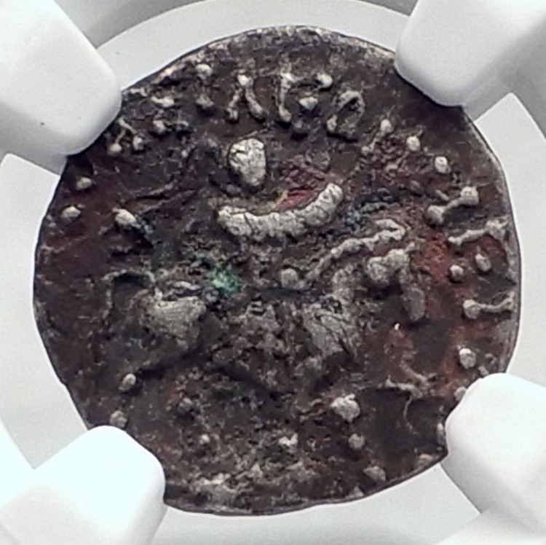
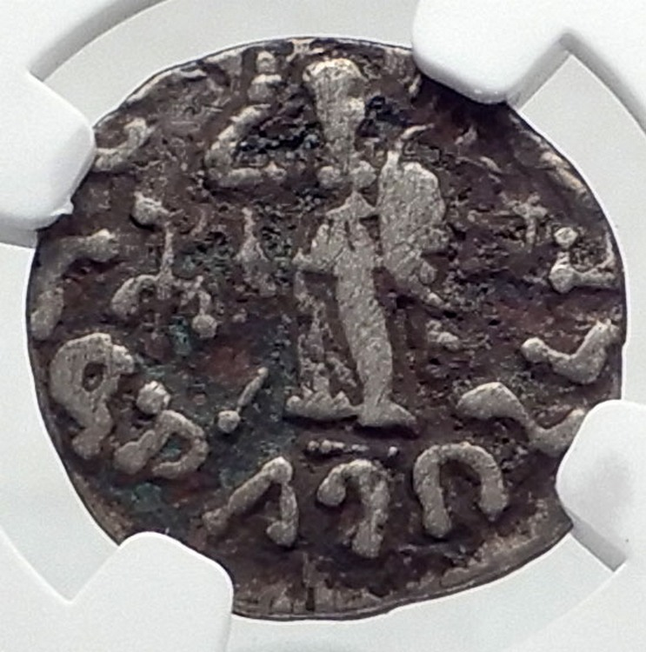
Jesus Christ Birth Magii Azes II on Horse Ancient Silver Coin
* Numismatic Note: This coin circulated around the time of the birth of Jesus Christ. It is from the area far east in the Indo-Scythian Kingdom in Northern India. This type of coin could have been carried by the Magii that went to see Jesus from the east. Gold, frankincense, and myrrh was available and traded in the area of northern India and was something that would be brought west from there. India was a great source for spices and other exotic goods and caravans would travel from there bringing them for trade. It is believed that Jesus may have been born back as far back as 5 B.C. based on some of the biblical accounts. If this king lived up to 5 B.C. or later, which may be possible, he could have been then one of the kings that visited Jesus at his birth. Or if this coin was carried by the Magii, his coin could have came and visited Jesus. Since these kings may have traveled on horses, a king of those times would look like the king pictured on this coin. And it is also possible that one of his successors could have been some of the kings that visited Jesus at birth. Then again, they would have with them the circulating coin of the realm, and some of those which could have been the coin of this ruler. It is amazing to hold this coin connected to that amazing historical period.
Indo-Scythian Kingdom in Northern India King Azes II - Indo-Scythian King - Reigned: circa 35 B.C.- 12 B.C. or later, possibly up to 5 A.D. Silver Drachm 15mm (1.90 grams) Struck circa 35 B.C. - 12 B.C. / 5 A.D. Reference: HGC 12, 651 (Rare R1) King with coat of mail, on horse, holding elephant goad, with Greek royal headband; Kharoshthi letter to right. Greek legend BAΣIΛEΩΣ BASIΛEΩN MEΓAΛOY AZOY "The Great King of Kings Azes". Athena standing right, holding shield and making benediction gesture. Monogram to right and Kharohthi letter to left. Kharoshti legend MAHARAJASA RAJADIRAJASA MAHATASA AYASA "The Great King of Kings Azes".

Slide 10
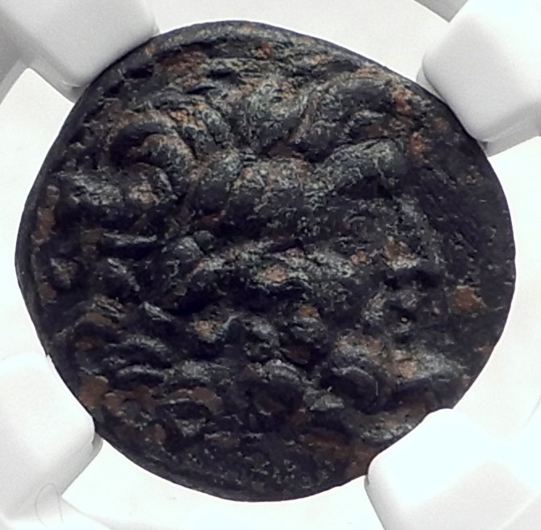
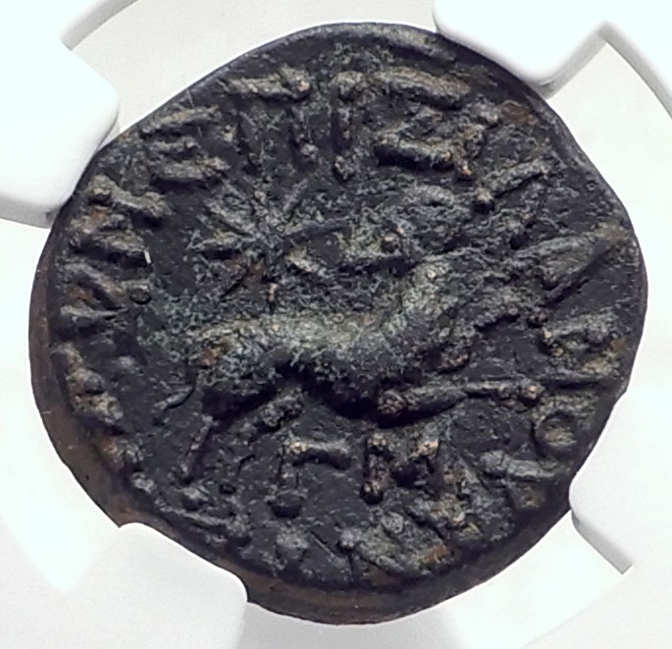
JESUS CHRIST Birth STAR of BETHLEHEM Ancient Greek ANTIOCH Coin RAM NGC i80395
" In 1999 , Dr. Michael Molnar , a Christian astronomer, published “The Star of Bethlehem - The Legacy of the Magi.” H is findings included the meaning behind the “Ram and Star” coins from Antioch along with the most likely “ heavenly alignment” constituting the “Star of Bethlehem . ” He concluded that the design was meant to recognize the birth of the Messiah in Judaea and that His birth occurred o n April 17, 6 BC. Since his book was published, I have continuously accumulated these coins by date and conducted research into the purpose of their minting . My conclusions not only confirm Dr. Molnar’s findings but also show that this “Star of Bethlehem” motif was used frequently between 6 AD and 253 AD . Ultimately, there are over 20 different dates for these commemorative coins and the dates cluster around major anniversary dates of Yeshua’s (Jesus’) “birth” and/ or “death and resurrection .” "
Greek city of Antioch on the Orontes in Seleukis and Pieria STAR of BETHLEHEM ISSUE Bronze 20mm (6.44 grams) Struck during Augustus' reign, circa 12/13 A.D. under governor Silanus Reference: RPC I 4268 Certification: NGC Ancients XF 4285435-015 Laureate head of Zeus right. EΠI ΣIΛANOY ANTIOXEΩN, Ram leaping right, looking back at large star star (Constellation Aries), ΓM below (= year 43 of the Actian era).

Slide 11
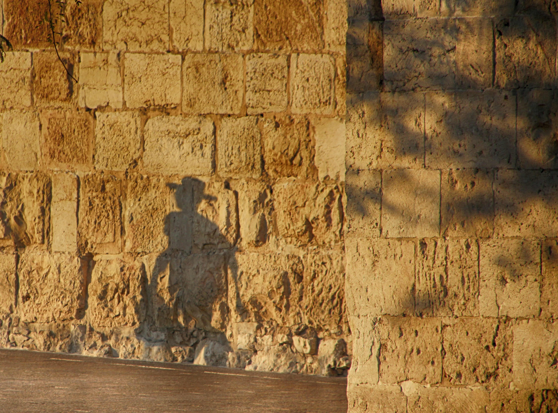
King Herod the King of Jesus Birth
Jesus Christ may have been born as far back as 6 or 5 B.C. in actual essence, so at that time the coins of king Herod circulated.
King Herod built the outer wall to the Great Temple and a portion of it still exists and it is known in Jerusalem as the Wailing Wall. He also built the town of Caesarea and Masada.

Slide 12
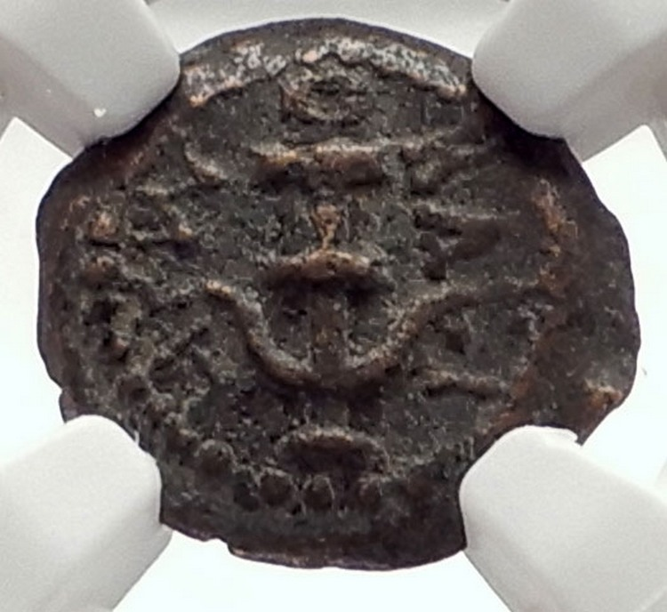
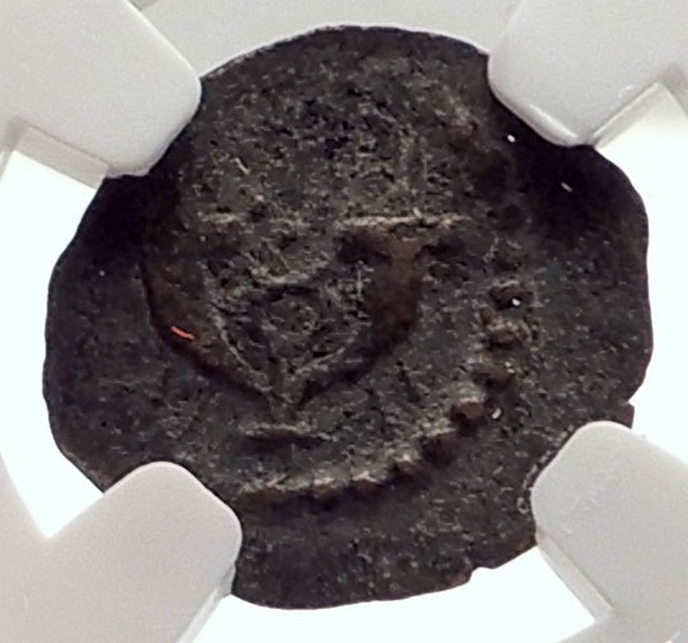
Kingdom of Judaea Herod I, the Great - Jewish King: 40-4 B.C. Bronze Prutah 13mm Jerusalem mint, struck circa 22-9 B.C. Reference: Hendin 500 (3rd Edition); Hendin 1188 (5th Edition) Anchor; HPW BACI around. Double cornucopia with caduceus between, dots above.
This coin with the symbolism of the anchor may relate to the founding of Herod's magnificent port at Caesarea Maritima circa 22-9 B.C. Herod was the king during the birth of Jesus Christ, which modern scholars attribute to about as far back as 6 B.C. He is the man responsible for large building projects of architecture still known to this day including the wall surrounding the Great Temple, that a portion of is left of in Jerusalem, referred to as the "Wailing Wall"; and the fortress at Masada.

Slide 13
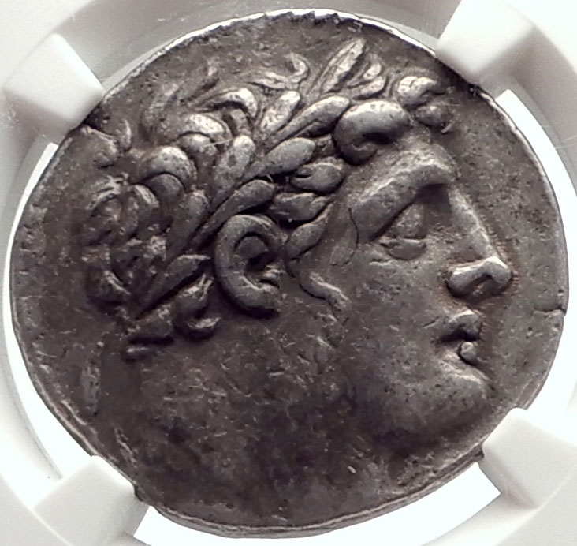
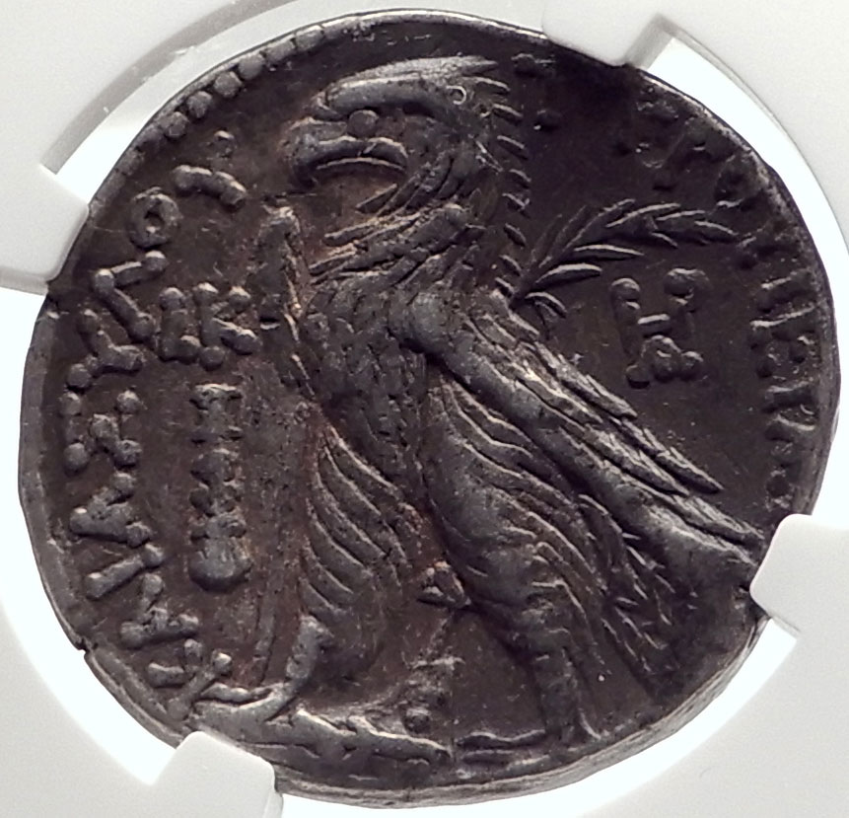
The Second Temple tax coin that the Jewish people of Jerusalem paid in, known as the "Shekel of Tyre".
A coin like this is known to the Christian Gospels as the coin found in "St. Peter's Fish".
These are the coins that other coins were being exchanged for when Jesus Christ "attacked" the money changers, flipping over their tables and whipping them. This narrative is known as the "cleansing of the Temple".
It is believed that it is either this type of silver coin, or another from the local city of Antioch with the Roman emperor's portrait that could have been one of the infamous "Thirty pieces of silver" bribe paid to Judas to betray Jesus.
Greek city of Tyre in Phoenicia Authentic "Jewish / Christian Biblical Coin" of Historical Importance Silver 'Shekel' Tetradrachm 27mm (13.99 grams) Tyre mint, dated year 20, struck 107/106 B.C. Reference: Sear 5918 var.; HGC 10, 357; DCA Tyre supplement 2.20, 58; BMC Phoenicia 91 Laureate head of beardless Melqarth right, lion's skin knotted around neck. TYPOY IEPAΣ KAI AΣYΛOY, Eagle standing left on beak of ship, carrying palm under right wing; in field to right, HPA monogram; in field to left, club and LK (date) above it; Phoenician bet between legs.

Slide 14
The Saint Peter’s Fish Coin
Matthew 17:24-27 King James Version (KJV)
²⁴ And when they were come to Capernaum, they that received tribute money came to Peter, and said, Doth not your master pay tribute?
²⁵ He saith, Yes. And when he was come into the house, Jesus prevented him, saying, What thinkest thou, Simon? of whom do the kings of the earth take custom or tribute? of their own children, or of strangers?
²⁶ Peter saith unto him, Of strangers. Jesus saith unto him, Then are the children free.
²⁷ Notwithstanding, lest we should offend them, go thou to the sea, and cast an hook, and take up the fish that first cometh up; and when thou hast opened his mouth, thou shalt find a piece of money: that take, and give unto them for me and thee.

Slide 15
Jesus Cleanses the Temple
Matthew 21:12–17, Mark 11:15–19, and Luke 19:45–48) and near the start in the Gospel of John (at John 2:13–16)
John 2:13-16 King James Version (KJV)
¹³ And the Jews' passover was at hand, and Jesus went up to Jerusalem.
¹⁴ And found in the temple those that sold oxen and sheep and doves, and the changers of money sitting:
¹⁵ And when he had made a scourge of small cords, he drove them all out of the temple, and the sheep, and the oxen; and poured out the changers' money, and overthrew the tables;
¹⁶ And said unto them that sold doves, Take these things hence; make not my Father's house an house of merchandise.

Slide 16
The Infamous 30 Pieces of Silver Paid to Judas to Betray Jesus
There are two contenders that were to be the 30 pieces of silver to be paid to Judas. The actual temple coin that was also the Saint Peter’s fish coin or the Augustus Tetradrachm of the Antioch mint. If you think about the value that Temple tribute coins had as opposed to the pagan emperor, perhaps if you logically think about it it could have been either or even more likely to be the Augustus tetradrachm coin.

Slide 17
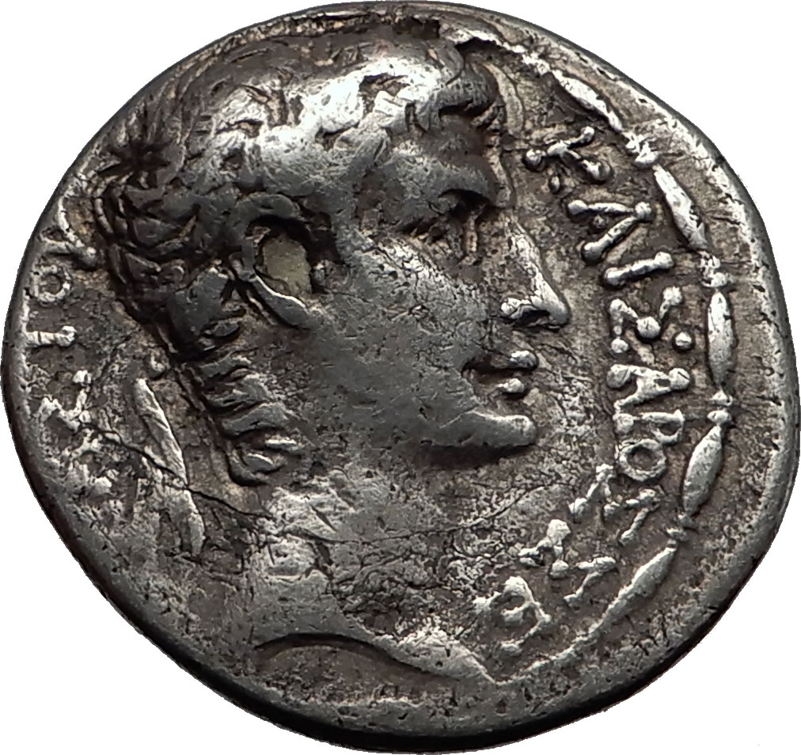
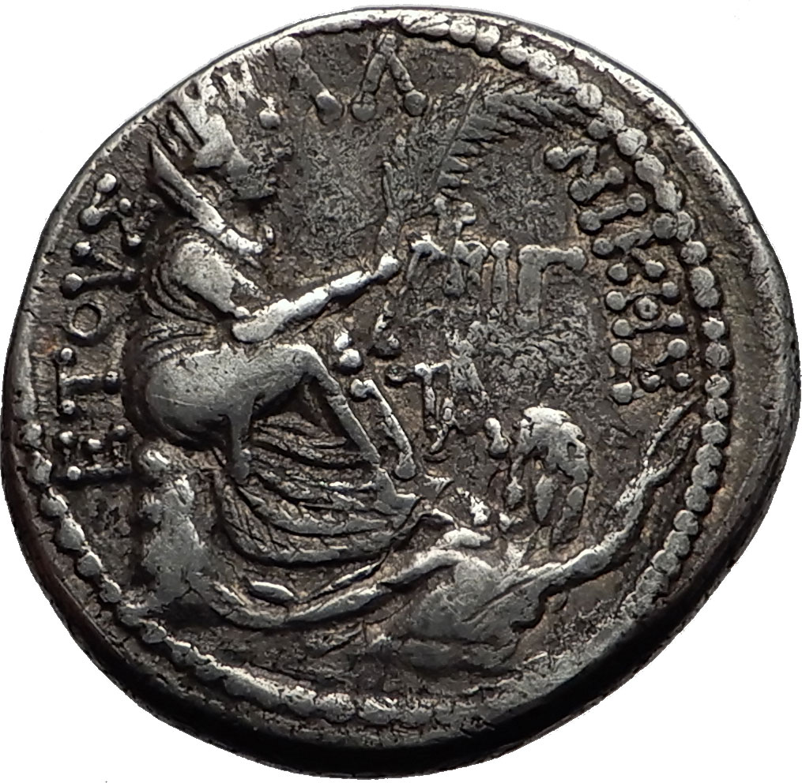
The 30 Pieces of Silver Judas Sold Out Jesus For
Matthew 26:15 King James Version (KJV)
¹⁵ And said unto them, What will ye give me, and I will deliver him unto you? And they covenanted with him for thirty pieces of silver.
Augustus - Roman Emperor: 27 B.C. - 14 A.D.
Infamous '30 Pieces of Silver' Judas' Betrayal of Jesus Christ Biblical Coin
Silver Tetradrachm 26mm (14.27 grams) of Antioch mint, Struck 1 B.C. / 1 A.D.
Dated year 31 of the Actian Era and Cos. XIII
Reference: McAlee 186; Prieur 56; RPC I 4157; DCA 400. Rare.
ΚΑΙΣΑΡΟΣ ΣΕΒΑΣΤΟΥ, Laureate head right.
ETOVΣ AΛ (Actian era date) NIKHΣ, Tyche seated right on rocky outcropping, holding palm frond; below, half-length figure of river-god Orontes swimming right; in right field, monogram (=ΥΠΑTOY) and IΓ (consular date) above monogram (=ANTIOXIEΩN?).
* Numismatic Note: This coin is considered to be a possible coin that was one of the "30 pieces of silver" that Jesus Christ was sold out for.

Slide 18
The Biblical Tribute Penny
Mark 12:14-17 King James Version (KJV)
¹⁴ And when they were come, they say unto him, Master, we know that thou art true, and carest for no man: for thou regardest not the person of men, but teachest the way of God in truth: Is it lawful to give tribute to Caesar, or not?
¹⁵ Shall we give, or shall we not give? But he, knowing their hypocrisy, said unto them, Why tempt ye me? bring me a penny, that I may see it.
¹⁶ And they brought it. And he saith unto them, Whose is this image and superscription? And they said unto him, Caesar's.
¹⁷ And Jesus answering said unto them, Render to Caesar the things that are Caesar's, and to God the things that are God's. And they marvelled at him.
SEE ALSO Matthew 22:17-21 King James Version (KJV)

Slide 19
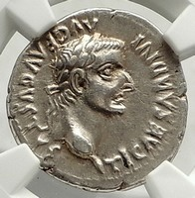
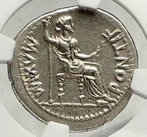
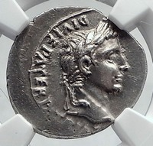
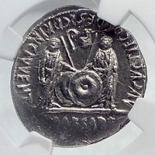
Tiberius - Roman Emperor: 14-37 A.D. THE BIBLICAL TRIBUTE PENNY Silver Denarius 20mm (3.66 grams) Lugdunum mint, struck circa 18-35 A.D. Reference: RIC I 30; Lyon 152; RSC 16a Certification: NGC Ancients Ch XF Strike: 5/5 Surface: 4/5 4934586-001 TI CAESAR DIVI AVG F AVGVSTVS, laureate head of Tiberius right. PONTIF MAXIM , Livia (as Pax), spear in right hand, olive branch in left, seated right on chair. This is the coin described in the bible as the "tribute penny".
Augustus - Roman Emperor: 27 B.C. - 14 A.D.
THE BIBLICAL TRIBUTE PENNY
Silver Denarius 19mm (3.79 grams) Lugdunum (Lyon) mint. Struck 2 B.C. - 2 A.D.
Reference: RSC 43; RIC I 207
CAESAR AVGVSTVS DIVI F. PATER PATRIAE, his laurel head right.
C . L . CAESARES AVGVSTI F . COS . DESIG . PRINC . IVVENT., Caius and Lucius Caesars standing facing, shields and spears between them; above, between the spears, simpulum and lituus turned inwards.
* Numismatic: There are two types of silver Roman coins that were described in the Tribute Penny, with this being one of the more likely two candidates, as it was a more common to circulation in the area where Jesus Christ lived.

Slide 20
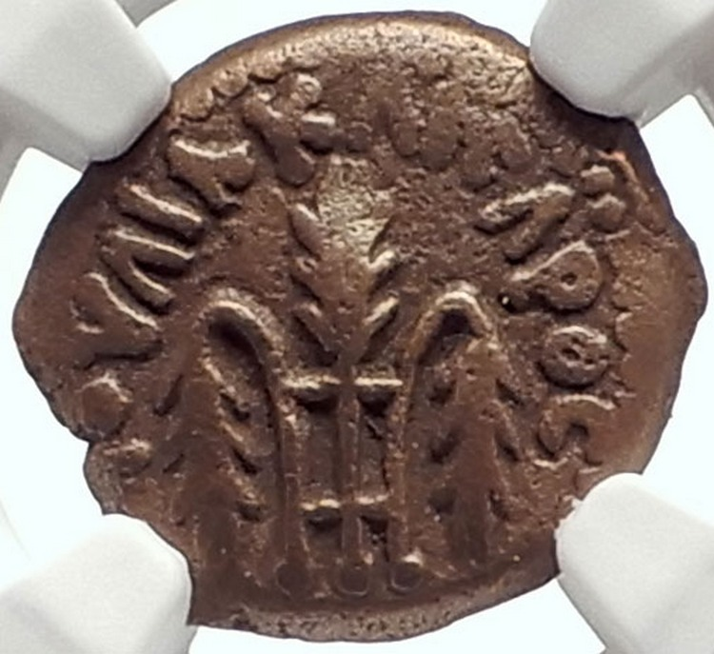
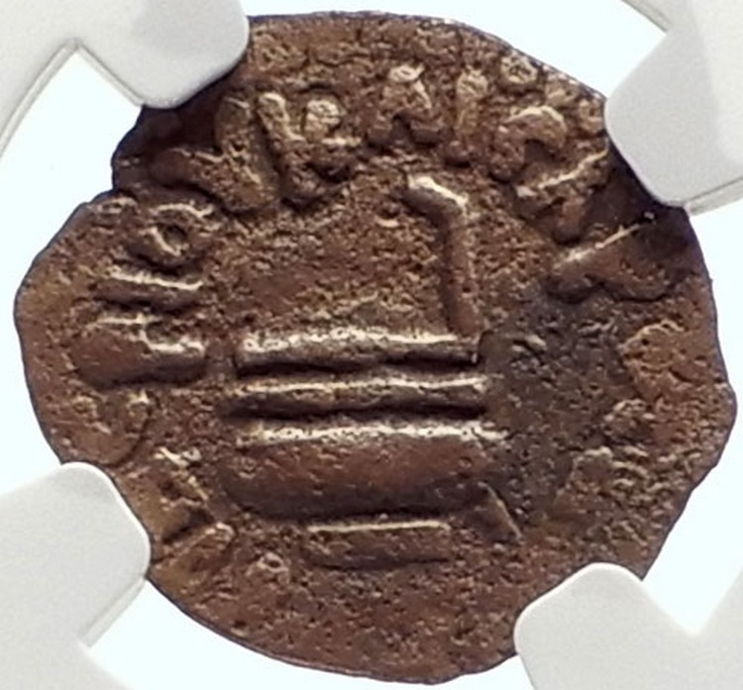
The Pontius Pilate Coins – Christ Crucifixion
Judaea - Holy Land Area Pontius Pilate - Prefect of Judaea: 26-36 A.D. under Tiberius - Roman Emperor: 14-37 A.D. Bronze Prutah 16mm (2.08 grams) Struck at the mint of Jerusalem 29/30 A.D. Reference: Hendin 1341 (5th Edition); Hendin 648 (3rd Edition) Certification: NGC Ancients Ch VF Strike: 4/5 Surface: 4/5 4680615-006 Obverse: Three bound ears of barley, the outer two ears droop, surrounded by IOYΛIA KAICAPOC. Reverse: Libation ladle (simpulum) surrounded by TIBEPIOY KAICAPOC (of Tiberius Caesar) and date LIC (Year 16).
* Numismatic Note: This authentic ancient coin was used in everyday trade during the lifetime of Jesus Christ in Jerusalem and surrounding areas. An important historically significant biblical coin of emperor Tiberius during whose rule Jesus Christ was crucified under the Roman prefect of Judaea, Pontius Pilate.

Slide 21
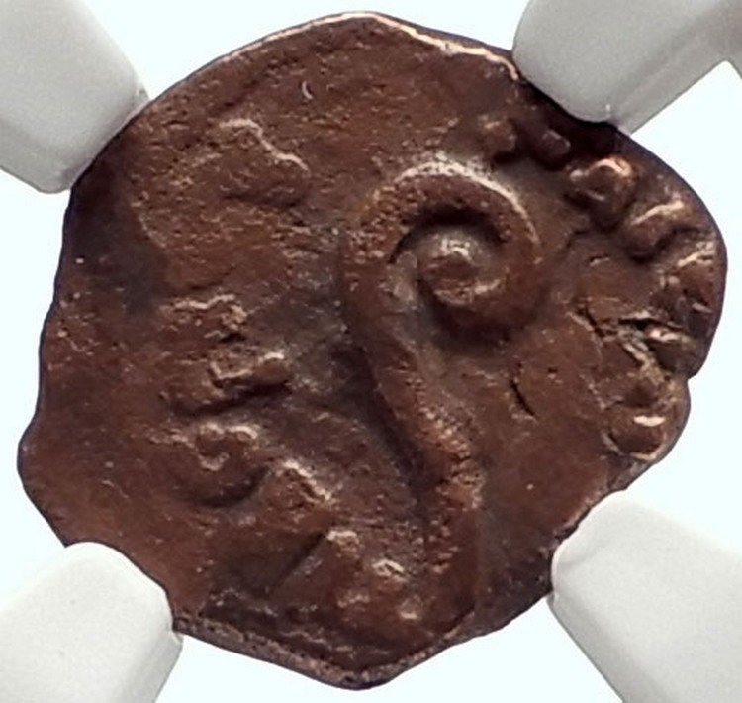
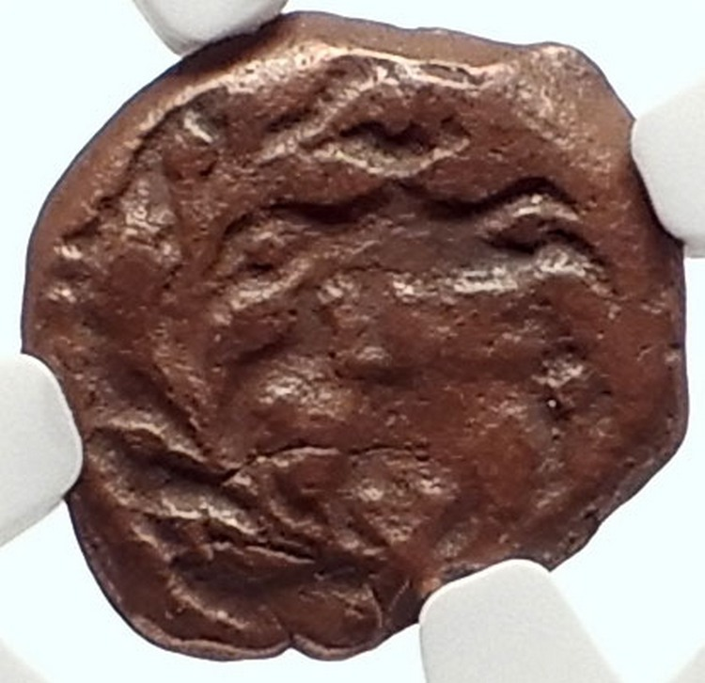
Judaea - Holy Land Area Pontius Pilate - Prefect of Judaea: 26-36 A.D. under Tiberius - Roman Emperor: 14-37 A.D. Bronze Prutah 15mm (1.89 grams) Struck at the mint of Jerusalem Jerusalem 30/31 A.D. Reference: Hendin 1342 (5th Edition) Certification: NGC Ancients VF Strike: 4/5 Surface: 4/5 4680615-010 Obverse: Lituus, surrounded by TIBEPIOY KAICAPOC (= Tiberius Caesar). Reverse: Date LIZ (= year 17 of Tiberius' reign = 30/31 A.D.) within wreath.

Slide 22
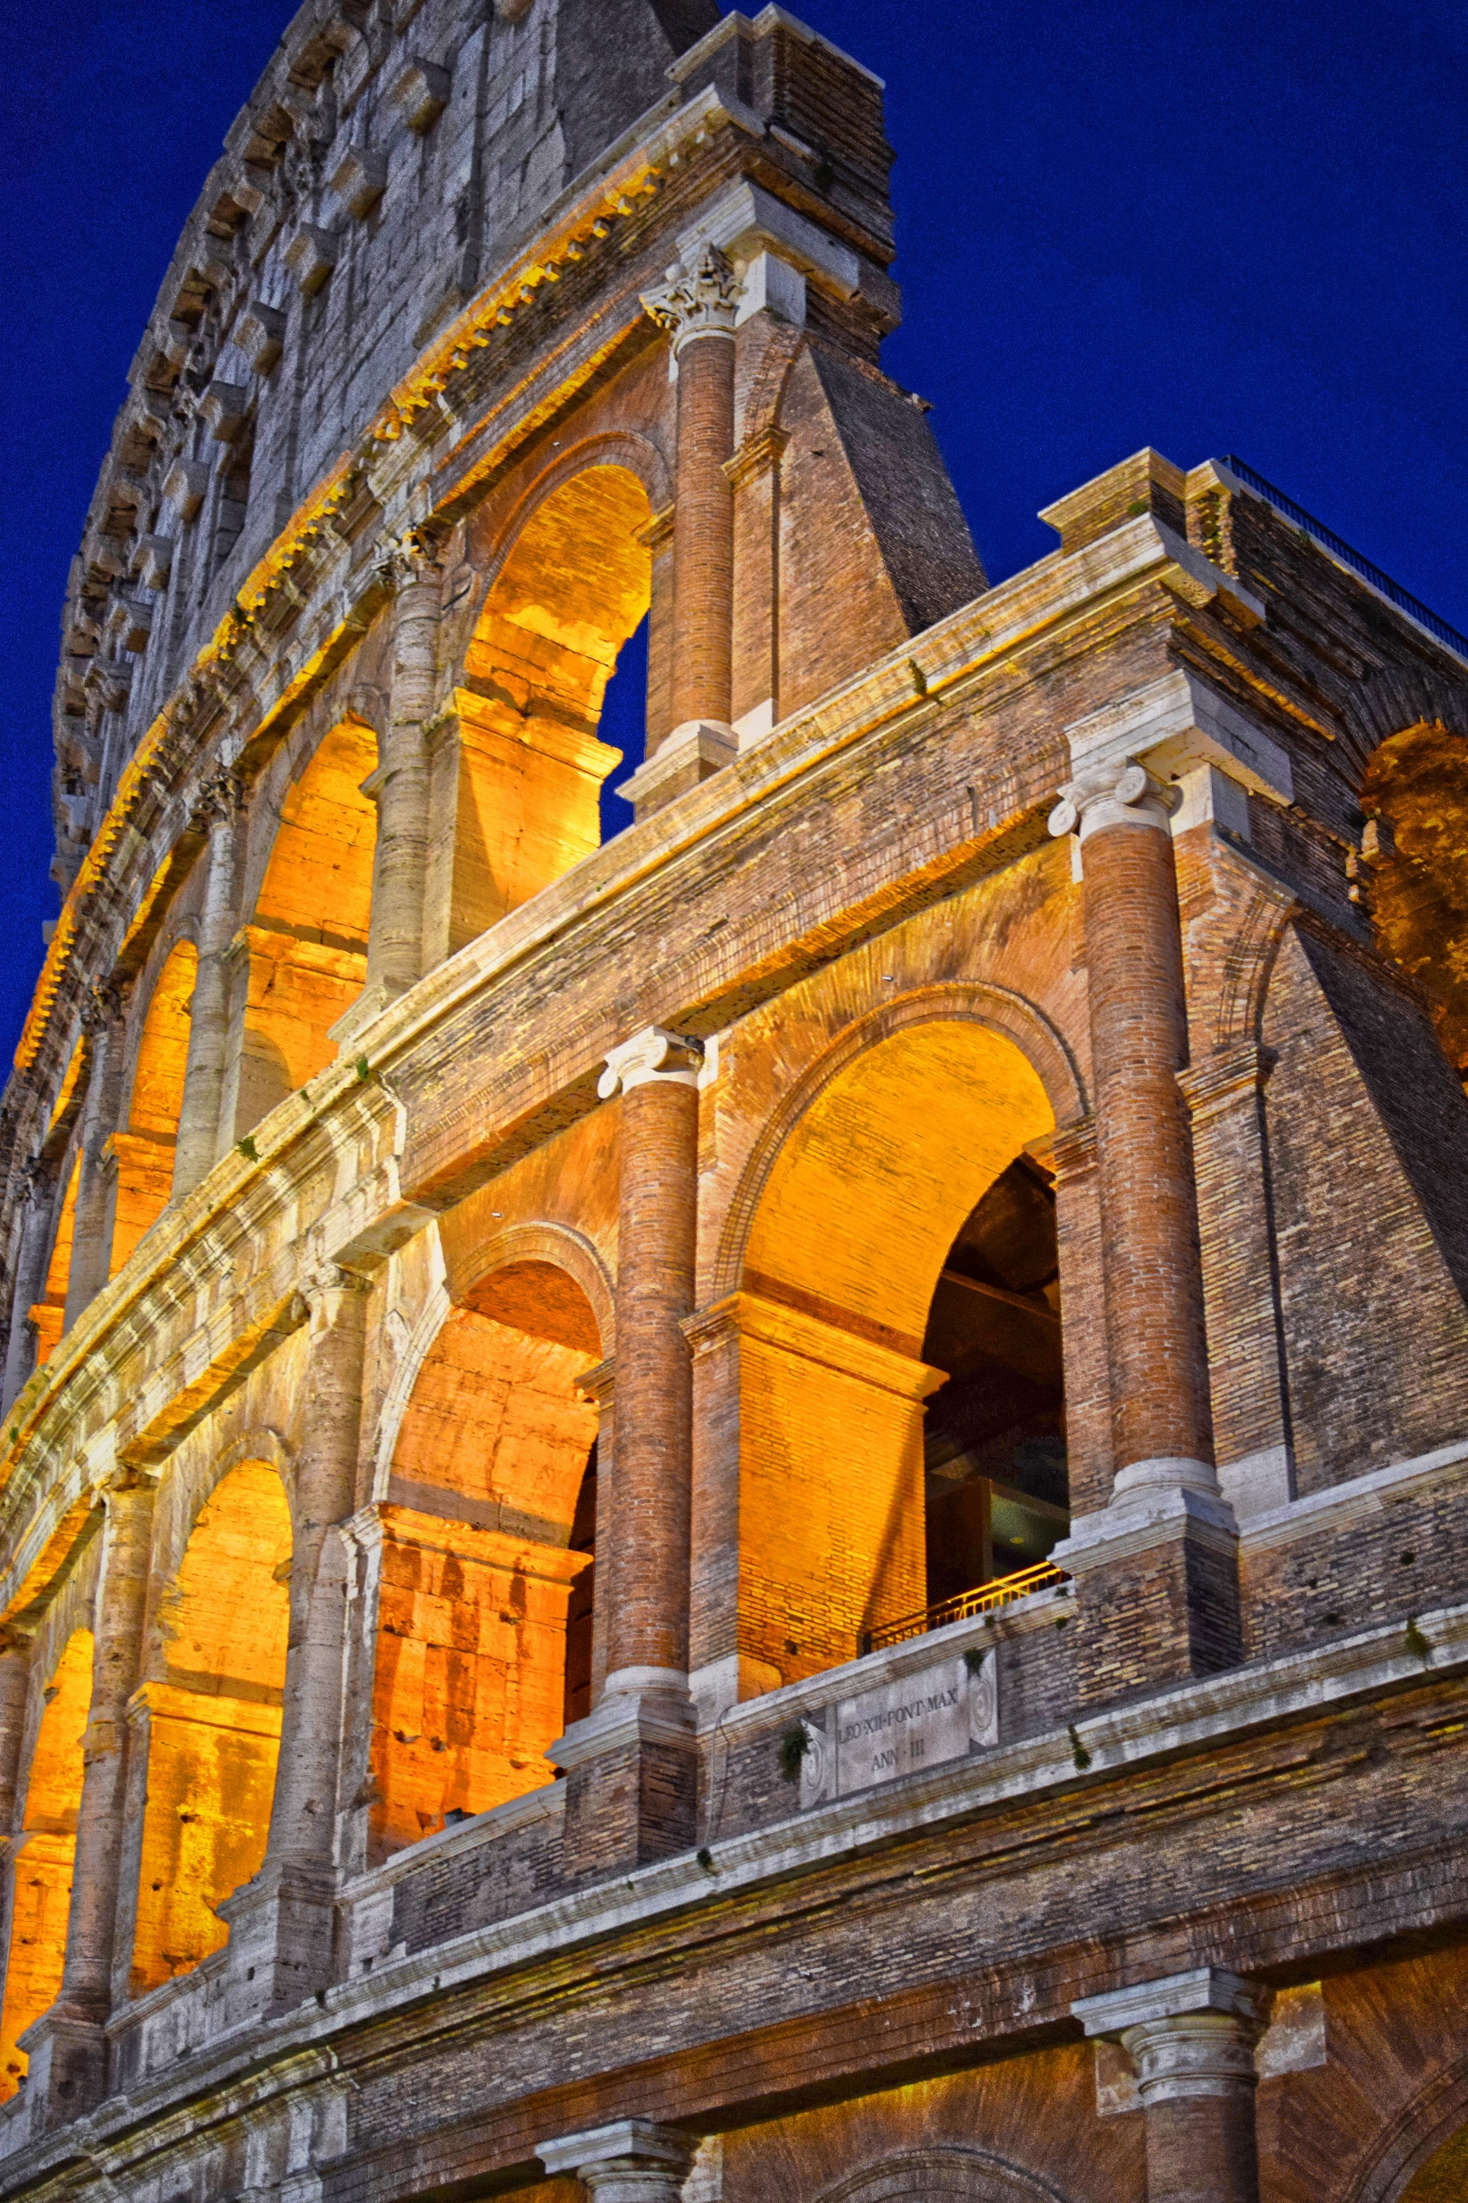
Nero Persecutes the Christians for their beliefs and blames them for the fire in Rome and Makes History
There was a great fire in Rome that burned down a large portion of the city giving rise to the term “Nero Fiddled” while Rome burned.
According the Roman historian Tacitus, Nero accused Christians of starting the fire in order to remove suspicion from himself. In this account, many Christians were arrested and brutally executed by "being thrown to the beasts, crucified, and being burned alive“
Nero also raises the taxes and debases the currency in order to build a great palace in Rome, which leads to the revolt of the Jewish people in Jerusalem and the burning down and the sacking of the Great temple of Jerusalem with the money plundered being used to build the Colosseum.
Saint Paul is brought for trial under Nero’s reign.

Slide 23
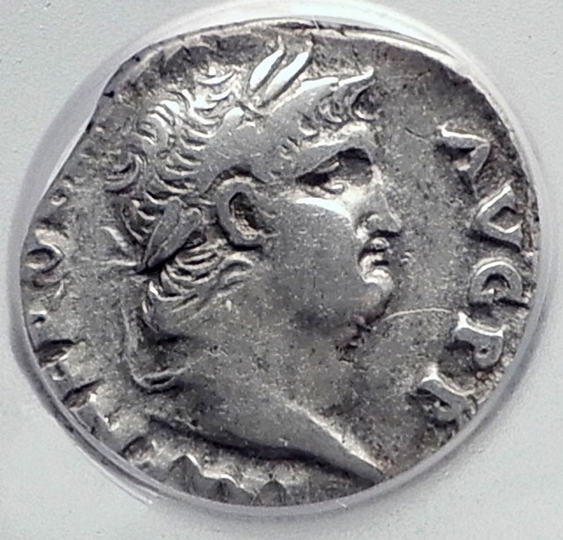
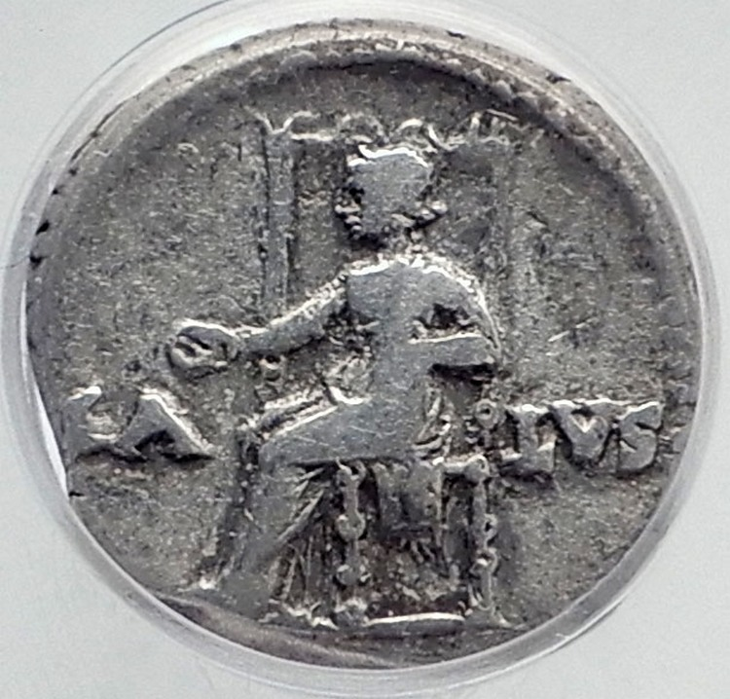
Nero - Roman Emperor: 54-68 A.D. Silver Denarius 17mm Rome mint, struck 67-68 A.D. Reference: RIC 72; RSC 320 IMP NERO CAESAR AVG PP, laureate head right. SA-LVS to either side of Salus seated left holding patera.

Slide 24
Saint Paul Original Named Saul of the Ancient Town of Tarsus Travels the Ancient World Preaching the Message – Travels of Saint Paul – Towns He Travelled
St. Paul's 1st Journey (Acts: 13:1-14:28)
Antioch in Selucis and Pieria
Salamis in Cyprus
Paphos in Cyprus
Perga in Pamphylia
Lycaonia
Lystra in Lycaonia
Derbe in Lycaonia
St. Paul's 2nd Journey (Acts 15:36-18:22)
Antioch, Selucis and Pieria
Tarsos in Cilicia
Derbe in Lycaonia
Lystra in Lycaonia
Iconium in Lycaonia
Antioch in Pisidia
Troas
Neapolis in Macedonia
Philippi in Macedonia
Thessalonica in Macedonia
Beroea in Macedonia
Athens in Attica
Corinth in Corinthia
Ephesus in Ionia
Paphos in Cyprus
Caesarea in Samaria
Jerusalem in Judaea
St. Paul's 3rd Journey
Antioin Selucis and Pieria
Iconium in Lycaonia
Ephesus in Ionia
Thessalonica in Macedonia
Corinth in Corinthia
Philippi in Macedonia
Miletos in Ionia
Rhodes
Paphos in Cyprus
Tyre in Phoenicia
Ptolemais in Samaria
Jerusalem in Judaea
St. Paul's Travels to Rome (Acts 15:36-18:22)
Caesarea in Samaria
Sidon in Phoenicia
Myra in Lycia
Crete
Malta
Syracuse in Sicily
Rhegion in Bruttium
Puteoli in Italy
Rome in Italy

Slide 25
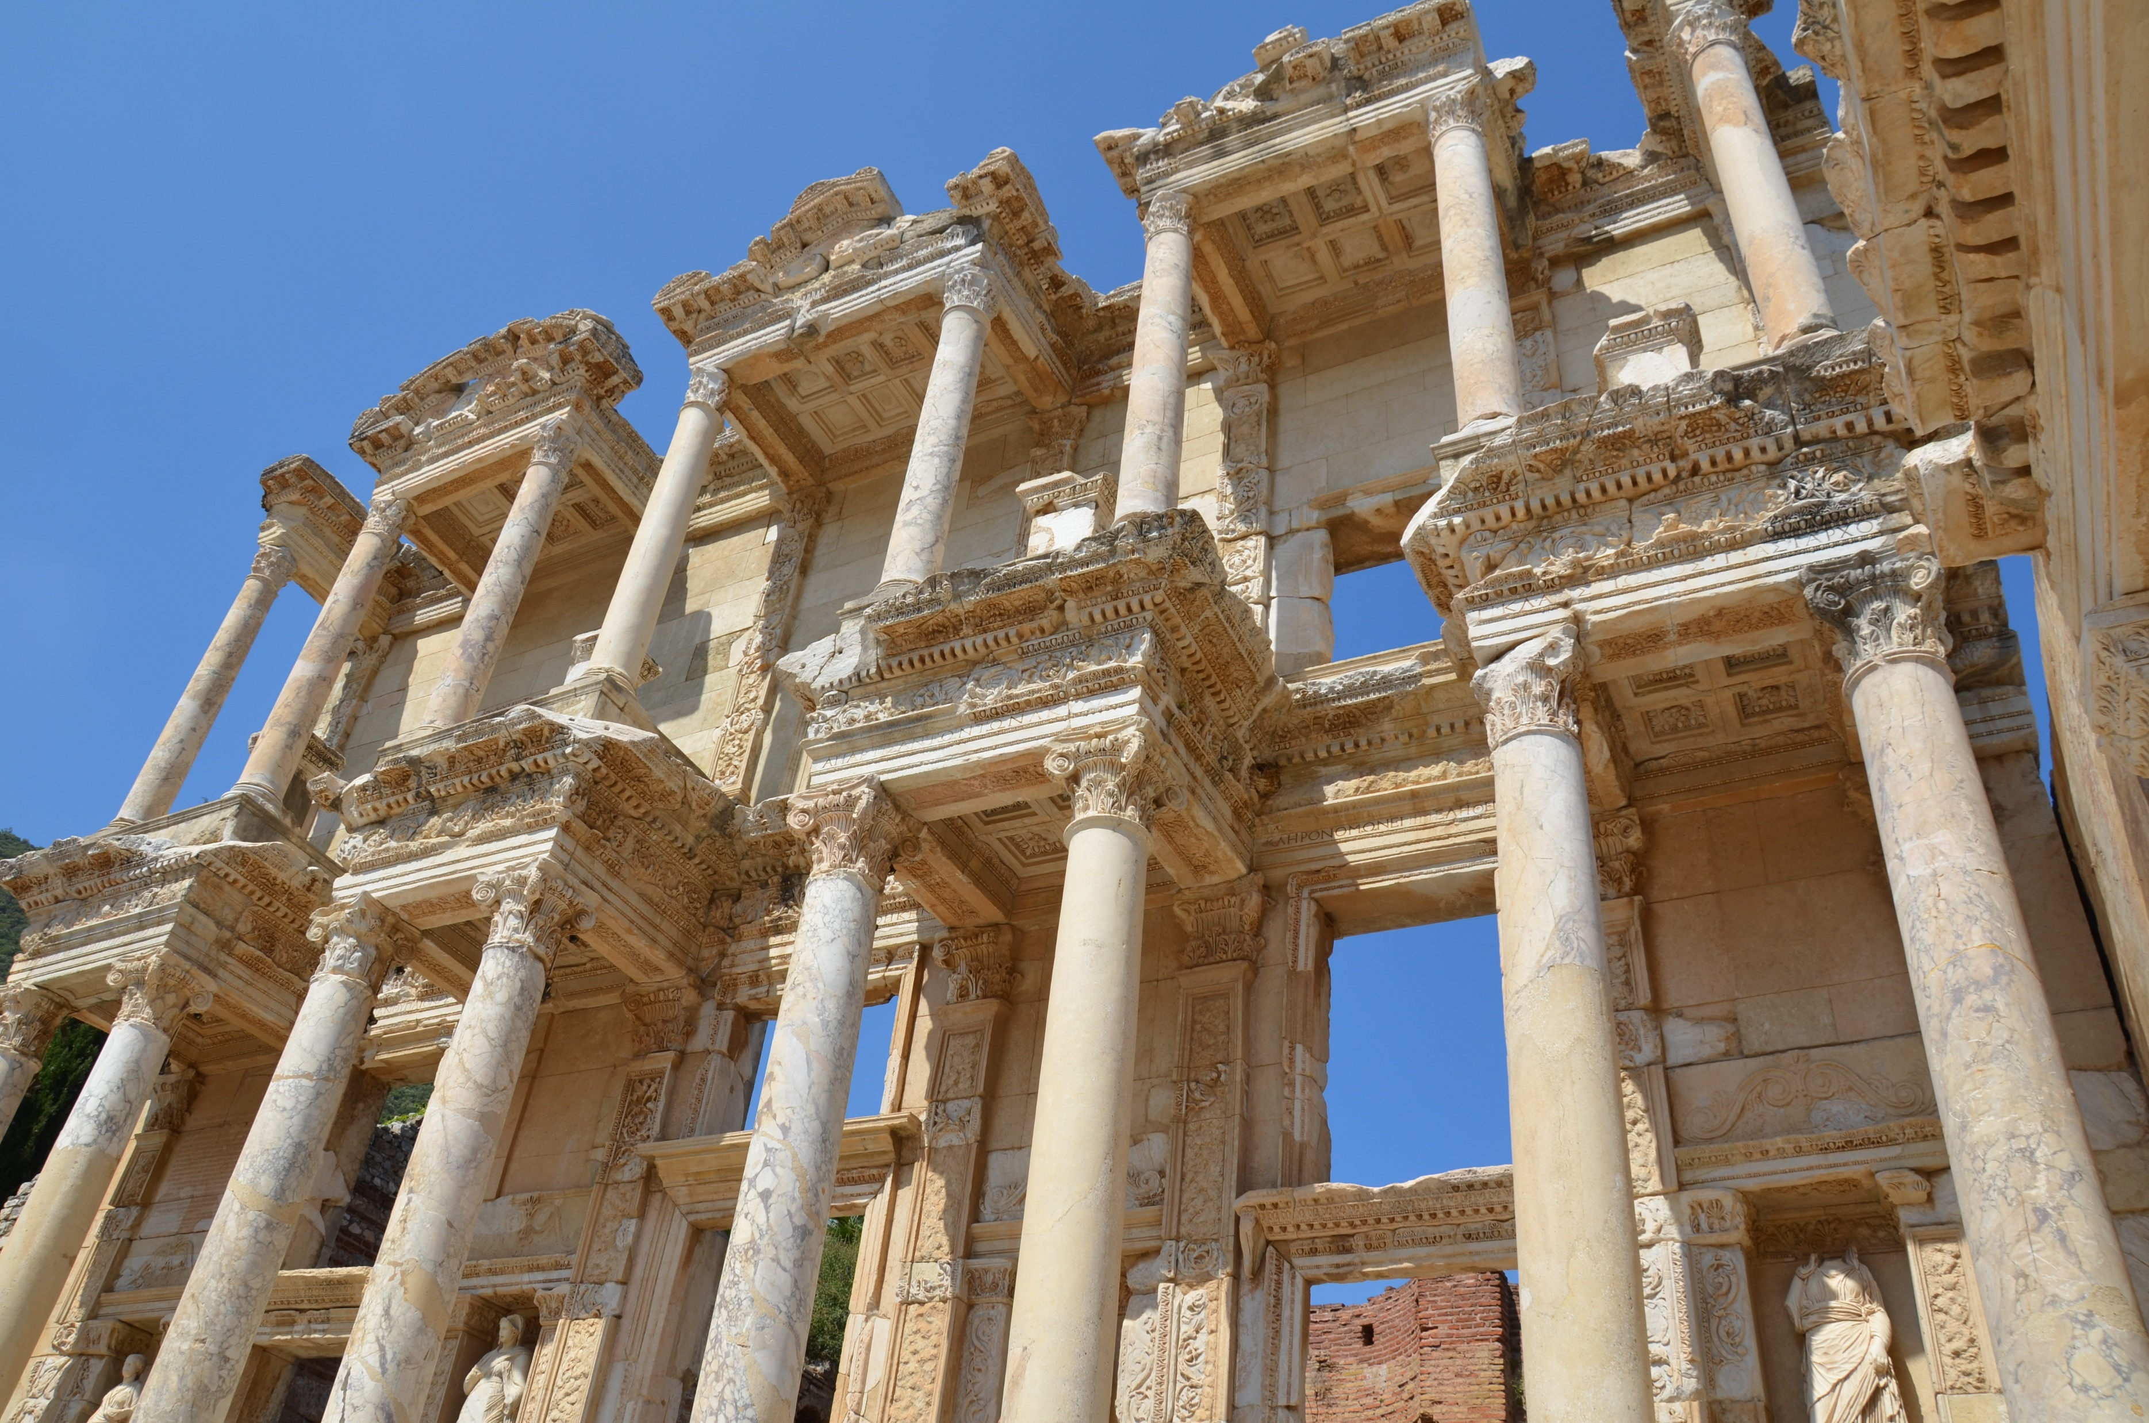
Saint Paul Gets Run Out of Ancient Ephesus for Going against the practice of idle worship
On his travels, Saint Paul visits Ephesus and gets run out of town as there was a ton of money being made making idols of the gods and goddesses of the ancient Greek and Roman world. The ruins are still visible to this day, and are a great place to visit.

Slide 26
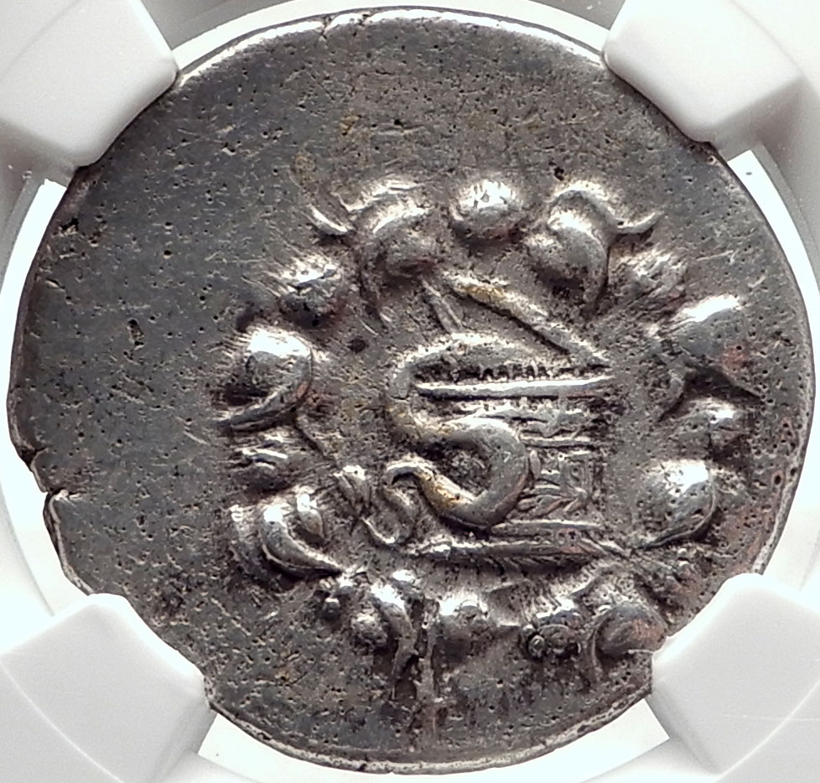
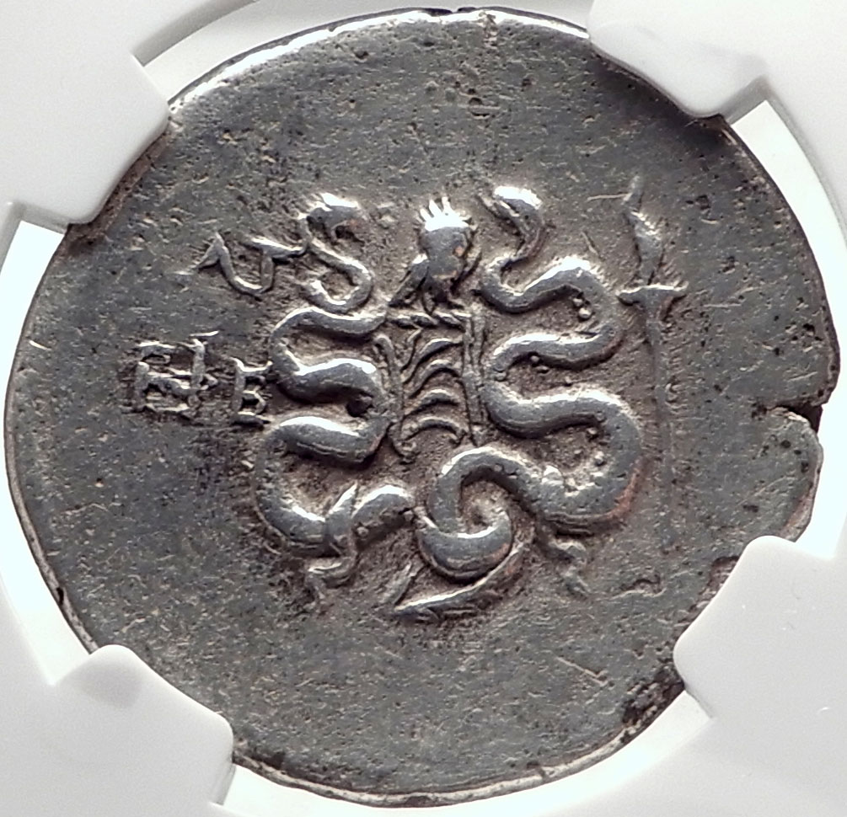
Greek city of Ephesos in Ionia Silver Cistophoric Tetradrachm (Cistophorus) 30mm. Dated Civic Year 33, 102/101 B.C. Reference: BMC -. SNG Copenhagen -. DCA 325, K37. Cista mystica with serpent; all within ivy wreath. Empty bow case between two serpents; owl above, palm below, ΛΓ (date) / EΦE in left field, lit torch in right field

Slide 27
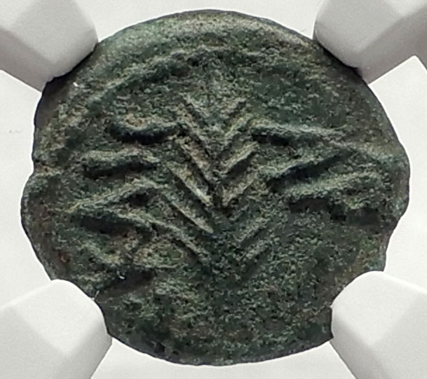
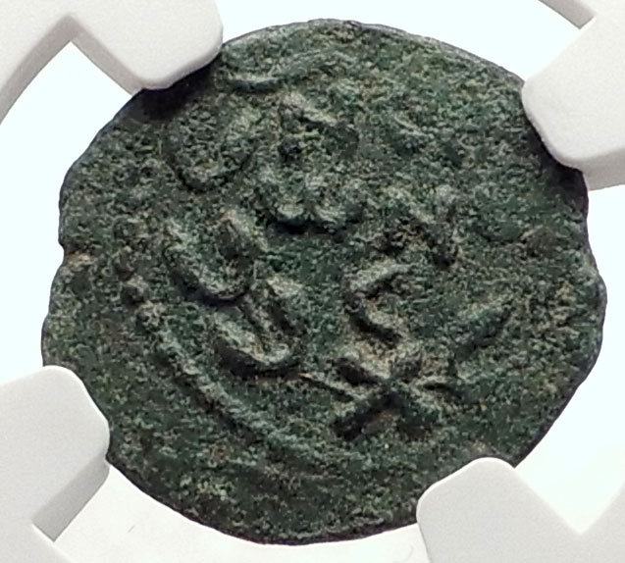
Saint Paul is Arrested in Jerusalem
He is arrested in Jerusalem before Porcius Festus and deported to Rome as Roman citizen in 58 A.D.
Acts 25:12-26
Biblical Jerusalem and Judaea under Roman Administration Porcius Festus, Procurator under Nero - Roman Emperor: 54-68 A.D. Bronze Prutah 16mm Jerusalem mint, struck 58/59 A.D. Reference: Hendin 1351 (5th Edition); Hendin 653 (3rd Edition) Greek letters KAICAPOC (Caesar) and date LЄ (year 5=58/59 A.D), palm branch. Greek letters NЄP WNO C (Nero) in wreath tied at the bottom with an X.

Slide 28
The Jewish People Revolt in Jerusalem Against Rome
The Christians and the Jews were almost indistinguishable in the early stages of Christianity, and the legal definition of Christian did not come about until around the time of emperor Nerva in about 96 A.D.
The Romans created a legal definition between Jewish Christians and Jewish people with the Jewish religion being legal and Christianity being an illegal movement.
They issued their own coins featuring the term Freedom of Zion and the year of the revolt.
They were defeated and the temple was sacked and the money from all the melted down gold and silver was later used to build the Colosseum in Rome also known as the Flavian Amphitheatre

Slide 29
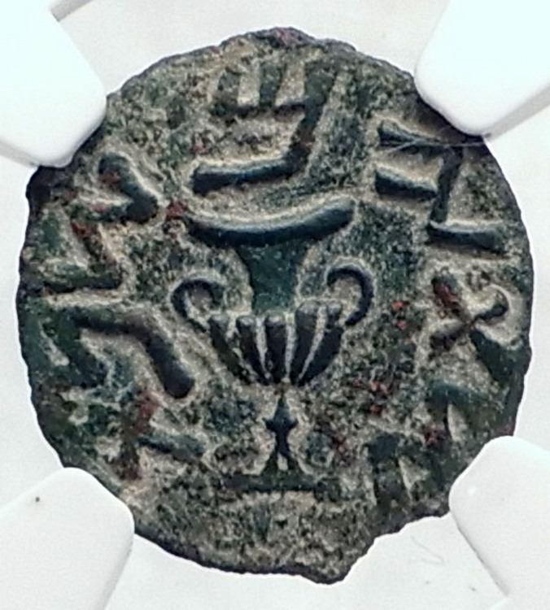
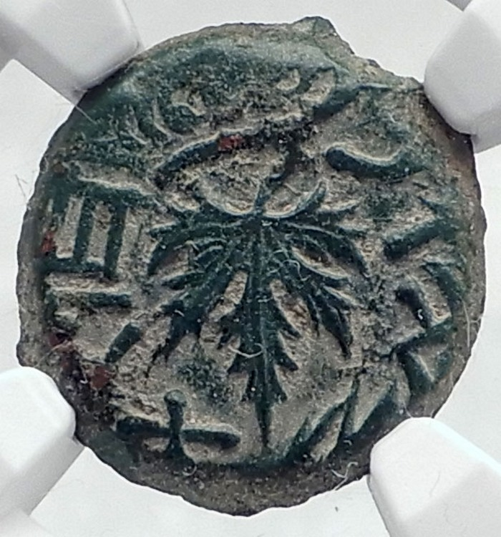
Jewish Coin of the First Jewish-Roman War "Great Revolt" Bronze Prutah 17mm Struck Year 2 of the Jewish War at the Jerusalem mint, April 67 - March 68 A.D. Reference: Hendin 1360 (5th Edition); Hendin 661 (3rd Edition) Jewish Amphora with broad rim and two handles; around Hebrew inscription for Year 2. Vine leaf on a branch and the Hebrew inscription: 'The Freedom of Zion'.

Slide 30
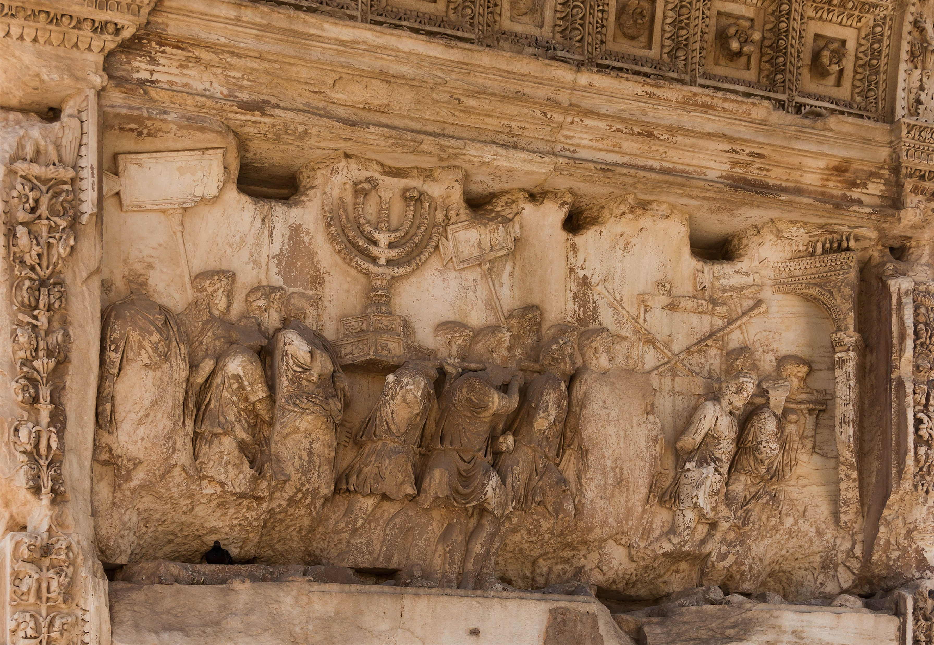

Slide 31
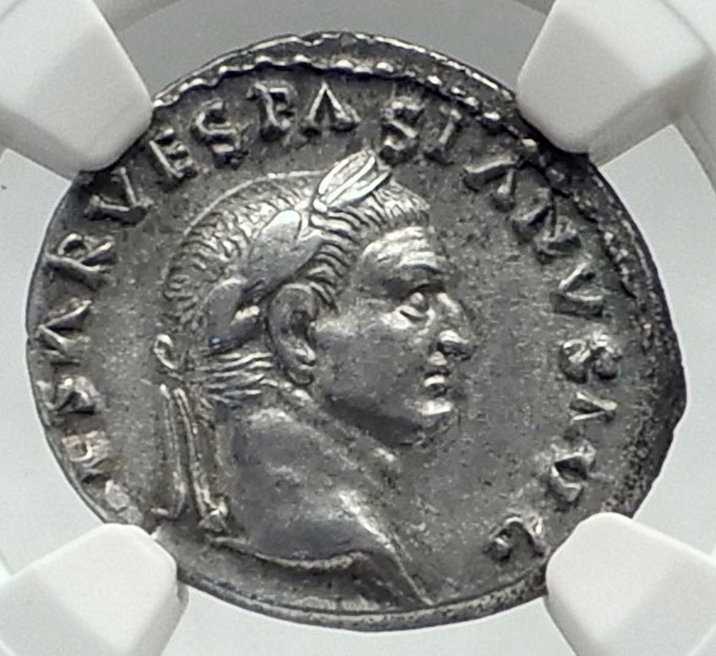
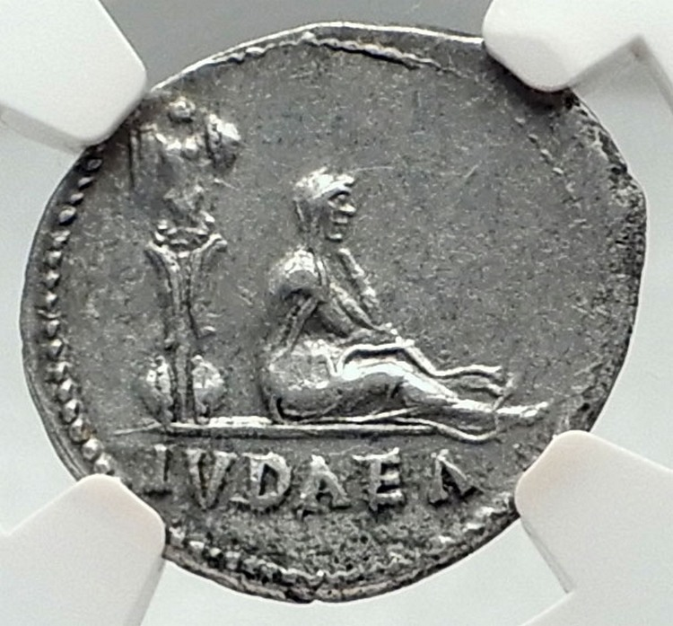
Vespasian - Roman Emperor: 69-79 A.D. "Judaea Capta" Silver Denarius 20mm (3.39 grams) Rome mint: 69-70 A.D. Reference: RIC 2; Cohen 226; BN 23; B.M.C. 35; Hendin 759 (3rd Edition); Hendin 1464 (5th Edition) Laureate head of Vespasian right; around IMP CAESAR VESPASIANVS AVG. Jewess seated right mourning below right of trophy; in exergue, IVDAEA.

Slide 32
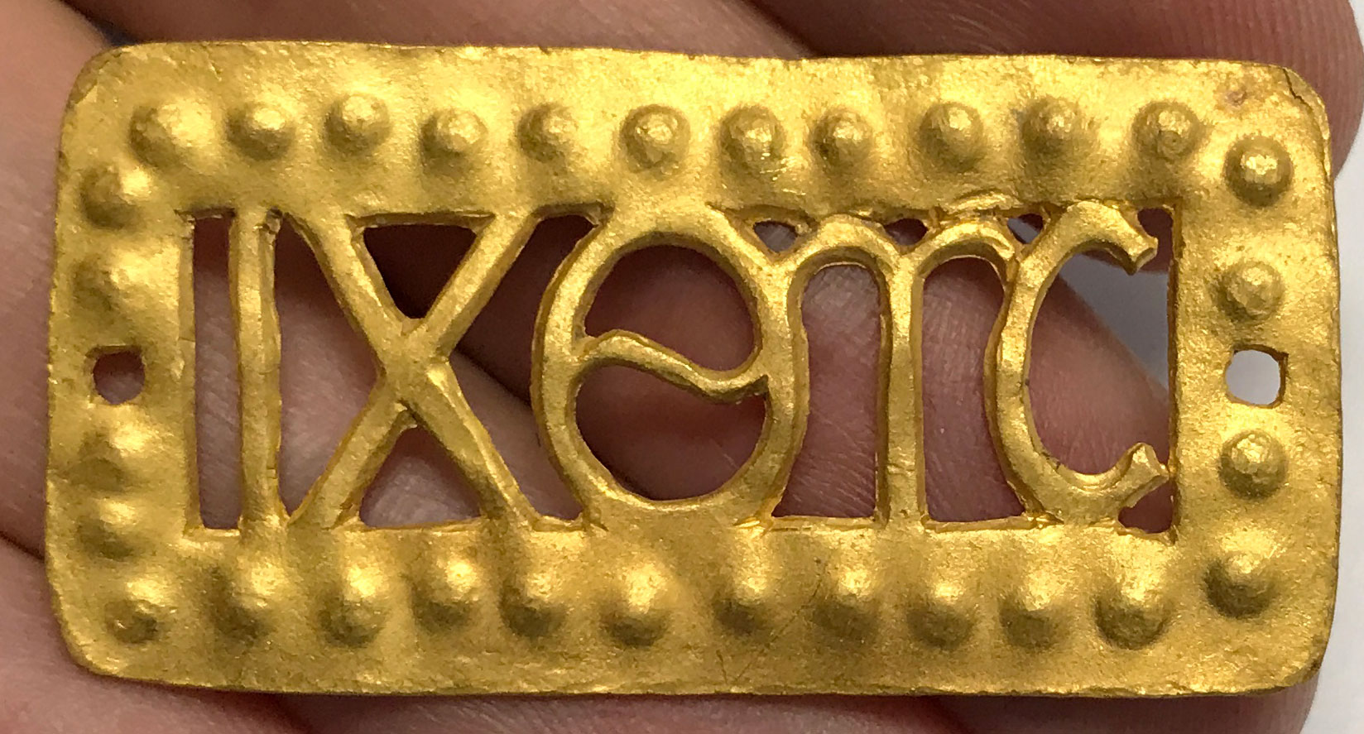
The Christians Go Underground Facing Persecutions and Keep Growing 2-3rd Centuries
100-300 A.D. Gold Roman Era Greek Inscribed Ichthus 'Fish' Plaque - Artifact | Weight: 8.72 grams | Material: Gold | 4.8 x 2.4 x 0.1 centimeters
ΙΧΘΥΣ would be a very early ancient Christian inscription having to do with Christianity with it translating to fish in English, thus what we know as the 'Jesus Fish'. ΙΧΘΥΣ (ichthys), or also ΙΧΘΥϹ with a lunate sigma, is an acronym/acrostic for "Ἰησοῦς Χριστός, Θεοῦ Υἱός, Σωτήρ" (Iēsous Christos, Theou Yios, Sōtēr), which translates into English as "Jesus Christ, Son of God, Saviour".

Slide 33
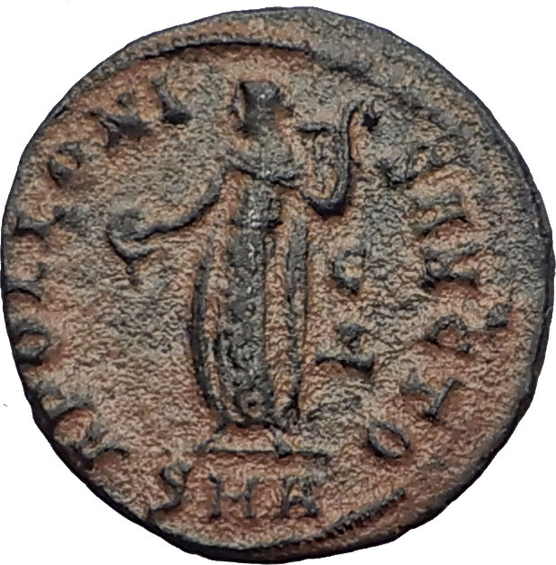
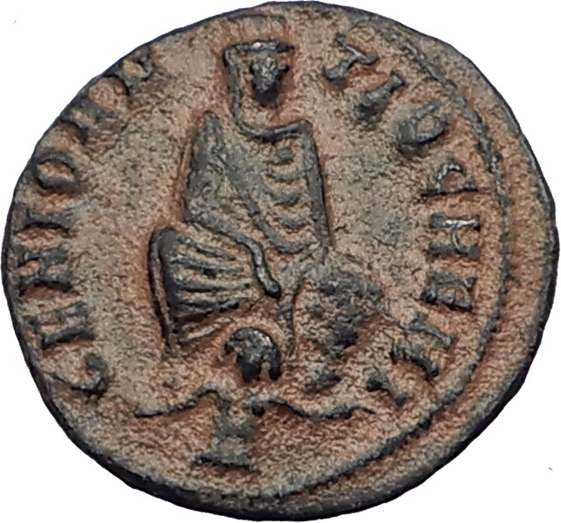
The Great Persecution of Christians 310-313 A.D.
Anonymous "Great Persecution of Christians Issue" struck under: Maximinus II, Daia - Roman Emperor: 308-313 A.D. - Bronze Quarter-Nummus 16mm (1.42 grams) Antioch mint, circa 310-313 AD. Reference: Vagi 2954; Cohen 1 [Julian II], van Heesch 92; McAlee 170; Failmezger 229 GENIO ANTIOCHENI, Tyche of Antioch enthroned facing, river god Orontes swimming at her feet. APOLLONI SANCTO, Apollo standing left holding patera & lyre, C over Δ in field to right , SMA in exergue.

Slide 34
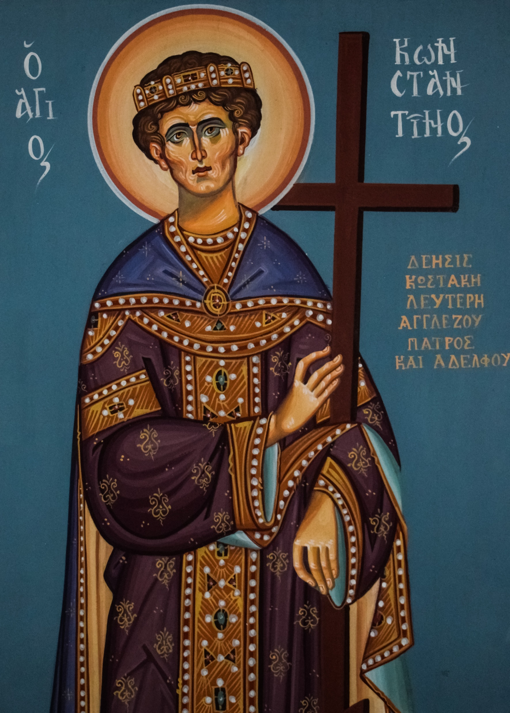
Constantine the Great aka Saint Constantine and Christianity
Sees sign from God and drawing symbol for Christ on shield to defeat his enemy at Milvian Bridge
Makes Christianity Official Religion of the Roman empire
HOC SIGNO VICTOR ERIS coins
Creates the Council of Nicaea in 327 A.D.
Is know as Saint Constantine
His mother is also known as Saint Helena

Slide 35
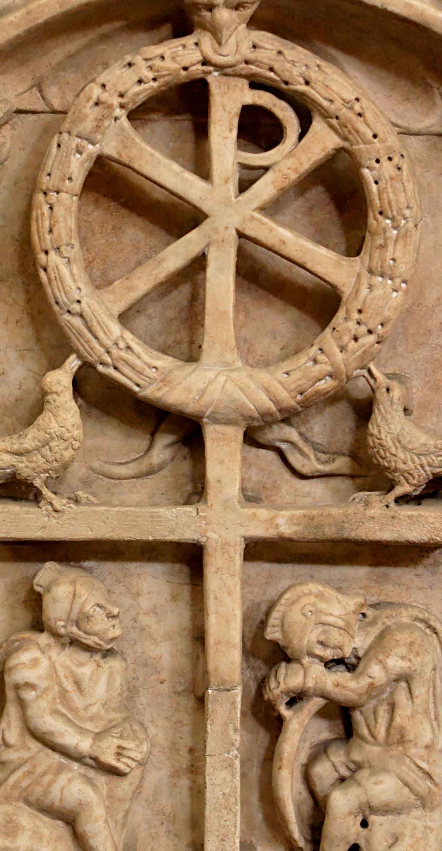
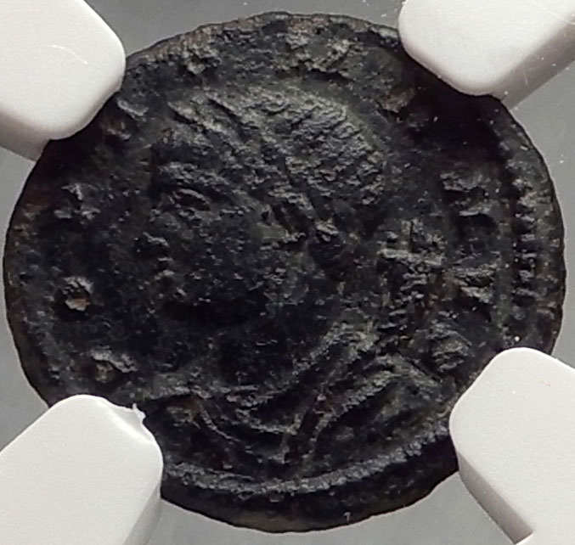
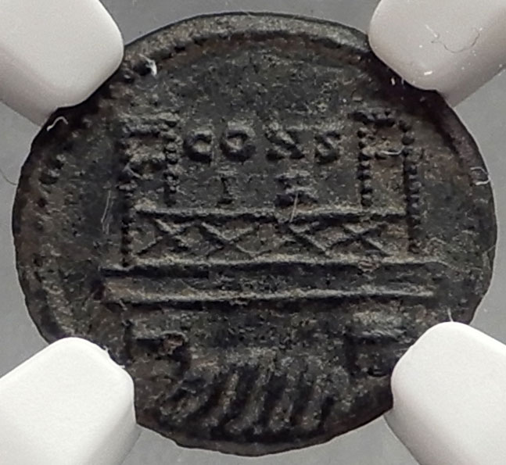
Constantine the Great uses the Chi-Rho Jesus Christ Monogram in battle versus Maxentius at Milvian bridge in 312 A.D.
Constantine I 'The Great' - Roman Emperor: 307-337 A.D. Bronze AE4 13mm (1.20 grams) Constantinople mint, struck circa 330 A.D. Reference: RIC 21 POP ROMANVS, draped bust of Genius left, cornucopia on shoulder. Ostensibly the Milvian Bridge over the river Tiber, CONS/IA above bridge. Struck in commemoration of the re-foundation of Byzantium as Constantinople, the reverse depicts the famed Milvian Bridge over the Tiber, where Constantine defeated Maxentius in October of AD 312.

Slide 36
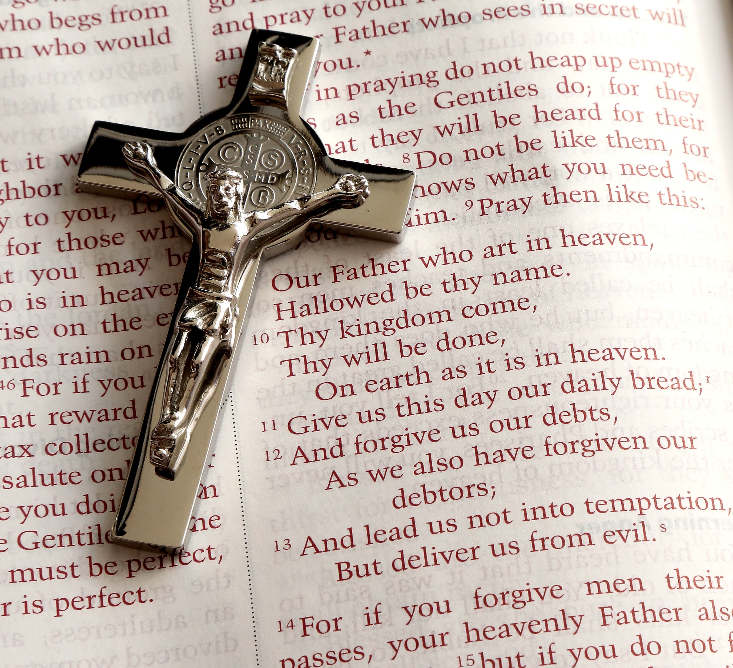
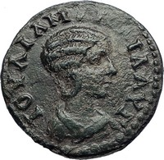
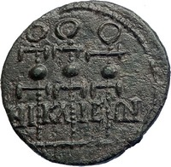
Council of Nicaea Held 325 A.D. establishes Christian Canon Law Standardizing Bible
Julia Mamaea - Augusta: 222-235 A.D. Bronze 21mm (4.60 grams) of Nicaea in Bithynia circa 222-235 A.D. Reference: BMC 105v; SNG Cop 521v (legend. breaks), SGI 3421 IOVLIA MAMAIA AVΓ, draped bust right. N-IK-AI-E-WN, between and beneath three legionary standards.

Slide 37
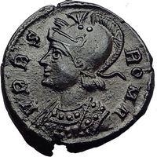
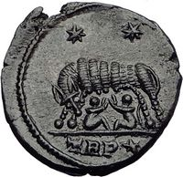
Constantine Founds Constantinople & Honors Rome
Constantine I 'The Great' - Roman Emperor: 307-337 A.D. Founding of a new Roman Capital - Constantinople Commemorative Bronze AE3 17mm Lyons mint, struck circa 330-331 A.D. Reference: RIC VII 246 CONSTANTINOPOLIS, Constantinopolis helmeted, laureate bust left, holding scepter over shoulder. Victory (Nike) standing left, stepping on galley prow, cradling scepter and resting hand on shield; mintmark •PLG in exergue below.
Constantine I 'The Great' - Roman Emperor: 307-337 A.D. Rome's Founding by Romulus & Remus Commemorative Bronze AE3 / Nummus 17mm (3.02 grams) Trier (Treveri) mint, struck 332-333 A.D. Reference: RIC 547 VRBS ROMA, helmeted, mantled bust of Roma left. She-wolf standing left suckling Romulus and Remus, two stars above TRP⁎ in exergue.

Slide 38
Constantine Passes on and Goes to Heaven 337 A.D.
Constantine I 'The Great' - Roman Emperor: 307-337 A.D. Divus Constantine Posthumous Christian Deification Issue Constantine in Chariot to Heaven with Hand of God Accepting Him Bronze AE4 14mm Struck circa 337-340 A.D. DV CONSTANTINVS P T AVG G, Veiled head of Constantine right. Constantine I, the Great, in quadriga (a four horse chariot) riding heavenward right reaching for manus Dei (hand of God) reaching down toward him above.

Slide 40
Saint Helena, mother of Constantine the Great finds Remnants of the True Cross
'Saint' Helena - Roman Empress 324-328/330 A.D. as Nobilissima Femina (AD 306-324) AE3 or BI Nummus 19mm (2.55 grams, 12 h) Thessalonica, struck under Constantine I, 318-319 A.D. Reference: RIC VII 50 HELENA N F, draped bust of Helena right, seen from front, hair brushed straight and bound in small chignon. Eight-pointed star within wreath terminating in large jewel.

Slide 41
Christian Symbols Used on Coins After Constantine
Chi-Rho / Christogram also on Labarum
Staurogram / Tau-Ro

Slide 42
Chi-Rho / Christogram with Alpha & Omega
Usurper Poemenius in the name of Constantius II - Roman Emperor: 337-361 A.D. Bronze AE2/Centenionalis 24mm (5.43 grams) Ostensibly of the Revolt of Poemenius, Trier mint, 2nd officina., struck mid 253 A.D. Reference: RIC 332. LRBC 67. Rare! D N CONSTAN - TIVS P F AVG, Pearl-diademed, draped and cuirassed bust of Constantius II right SALVS AVG NOSTRI Exergue: TRS☼, Large Chi-Rho; A - ω flanking. The Chi-Rho is the monogram of Jesus Christ. The A and W on the left represent the Alpha and Omega which Christ was described as in the book of Revelations.

Slide 43
Constantine’s Vision BY THIS SIGN CONQUER
Vetranio - in the name of:
Constantius II - Roman Emperor: 337-361 A.D.
Constantine the Great's Vision - "By This Sign You Shall Conquer"
Bronze Centenionalis 24mm (5.24 grams) Siscia mint:, 2nd Officina, under Vetranio, struck 350 A.D.
Reference: RIC VIII 282
D N CONSTANTIVS P F AVG, Pearl-diademed, draped and cuirassed bust right; A to left.
HOC SIGNO VICTOR ERIS ('by this sign you shall conquer')
The legend, Hoc Signo Victor Eris, translating to 'In This Sign Conquer', refers to Constantine's supposed vision of a giant chi-rho symbol in the sky prior to the Battle of Milvian Bridge against Maxentius in AD 312.
Labarum the Chi-Rho / Christogram Tipped Military Standard

Slide 44
Angel Stands with Tau-Ro Staurogram & Globe Cross
Byzantine Empire Maurice Tiberius - Emperor: August 13, 582-November 22, 602 A.D. Gold Solidus 21mm (4.43 grams) Antioch Mint, 5th Officina, struck circa 583-602 A.D. Reference: Sear 478 or 524 O N mAVRC-TIb P P AV, pearl-diademed, helmeted, draped and cuirassed bust of Maurice Tiberius facing, globus cruciger in right hand. VICTORIA AVG G Є, Angel standing facing, long staff terminating in staurogram (Tau-Rho) in right hand, globus cruciger in left; CONOB in exergue.

Slide 45
Theodosius II - Roman Emperor: 408-450 A.D. Bronze AE4 13mm (1.10 grams) Struck circa 425-435 A.D. D N THEODOSIVS P F AVG, Pearl-diademed, draped and cuirassed bust right. Cross within wreath.

Slide 46
Jesus Christ Depicted on Ancient Gold Byzantine Coin
Byzantine Empire Constantine VII, Porphyrogenitus - Emperor: June 6, 913 A.D. - November 9, 959 A.D. Gold Solidus 19mm (4.46 grams) Constantinople mint, 950-955 A.D. Reference: DOC 15. Sear 1751 +IhS XPS RЄX RЄςNANTIЧM, Facing bust of Christ Pantocrator, wearing tunic, himation and a cross nimbus with three pellets in the arms, raising right hand in benediction and holding book of Gospels in his left. CONSTANT' CЄ ROMAh' AЧςς bR', Crowned facing busts of Constantine VII, bearded and wearing loros on the left, and Romanus II, beardless and wearing chlamys on the right; both holding, between them with their right hands, a long patriarchal cross.

Slide 47
Anonymous LARGE Byzantine Jesus Christ Follis Coins Class A-N
Byzantine Empire - Anonymous Class A3 Bronze Follis 27mm (10.92 grams) struck circa 1020-1028 A.D. Reference: Sear 1813 + ЄMMANOVHΛ, Bust of Jesus Christ facing, wearing a nimbus crown, pallium and colobium, and holding book of Gospels with both hands; IC XC to left and right of bust. +IhSЧS / XRISTЧS / bASILЄЧ / bASILЄ ("Jesus Christ King of Kings") in four lines.

Slide 48
Crusader Coins & Kingdom of Cyprus
Cyprus as Crusader State Kingdom of Cyprus Hugh IV- King: 31 March 1324 – 24 November 1358 A.D. Silver Gros 27mm (4.60 grams) Reference: Malloy 67 + hVGVЄ | RЄI DЄb King seated on curule chair. + IЄRVSAL'M Є D' ChIPR (Translation: Jerusalem and Cyprus), Cross of Jerusalem.

Slide 51
BOOKS TO BUY ON THE SUBJECT:
Guide to Biblical Coins by David Hendin 5th Edition
https://www.amazon.com/Guide-Biblical-Coins-David-Hendin/dp/0965402959/
Money of the Bible, 3rd Edition by Kenneth Bressett (Author)
https://www.amazon.com/gp/product/079483955X/
Coins and the Bible by Richard Abdy (Author), Amelia Dowler (Author)
https://www.amazon.com/Coins-Bible-Richard-Abdy/dp/1907427309/

Slide 52
Values, Condition and Getting Best Prices
Values are determined by the free market. The realization we have to make is that a coin in pristine condition preserved to modern times is often a miracle on it’s on only a small percentage survive, so with beauty, comes desirability and with desirability and the condition’s r the price goes up higher.
The ideal is a happy medium where it is an attractive coin and moderately priced. Always try to buy coins that you find beautiful because chances are someone else may love them in the future as it may be a loved one or if you decide to sell them yourself.
Shop around, look around prices online, see if you can make offers, and feel open to make offers of even half the asking price because Ask and You Shall Receive Often Applies, or often ask a dealer, what is the best you can do on this one. Try to get receipts from everyone should you ever need to return it after sending to www.NGCCoin.com

Slide 53
You Can Buy Ancient Coins Online from Ilya here:
TrustedCoins.com eBay Store with over 19,000 Items 20,000 Positive Reviews
Certificate of Authenticity & LIFETIME GUARANTEE OF AUTHENTICITY included with all items purchased

Slide 54
Additional Videos & Links to Information Talked About
THIS PRESENTATION which includes more in-depth videos and articles to watch and read is available here:
trustedcoins.com/christianity
Get FREE Educational Articles About Coins Right to Your email:
LIST.trustedcoins.com

Slide 55
Thank You!
Kevin L. Tyler
HARRISBURG COIN CLUB
harrisburgcoinclub.com

